Slide 1
TRAINING MANUAL for
BLOs
(BOOTH LEVEL OFFICERS)
[PPT]
Disclaimer:
This training material is for use in training of election officials. It should not be referred as guidelines of ECI. In case of any variance in this training material and ECI guidelines/ rules/ laws, the ECI guidelines/ rules/ laws shall prevail.
Published in August, 2014 from
The India International Institute of Democracy and Election Management (IIIDEM),
Election Commission of India, New Delhi

Slide 2
CONTENTS
SESSION 1 (Slide No. 3 – 59)
  Motivation
  The Importance of Electoral Roll and its Accuracy
  The Importance of SR & of BLOs in it
  Map Making
SESSION 2 (Slide No. 60 – 94)
  Inclusion and Facilitation
  Forms and their Mock Filling
  BLO Kit
  Verification of E-Rolls
  [Lunch]
SESSION 3 (Slide No. 95 – 157)
  Importance of Procedural and Legal Discipline
  Health Analysis of E-Roll at the Booth Level
  Error/Problem Identification
  Strategy Formulation
  Case Studies, FAQs,
  End of Training Evaluation

Slide 3
FIRST SESSION

Slide 4
“Quality is not an act, it is a habit.”
- Aristotle

Slide 5
ICE BREAKER
A spool (or reel) of string or wool for is needed for this game. Ask the trainees to stand in a circle. (If a spool is not possible, then numbered chits could be given). Hold on to the end of the string and throw the ball/spool to one of the trainees to catch. That person then narrates one of his/her field experiences/challenges related to E-Rolls (or any other election process) and how s/he overcame it.
Holding a part of the string, each participant then throws the spool to another member of the group one after another.
Eventually this creates a web of the string, as well as a connectedness based on sharing of experiences and knowledge.

Slide 6
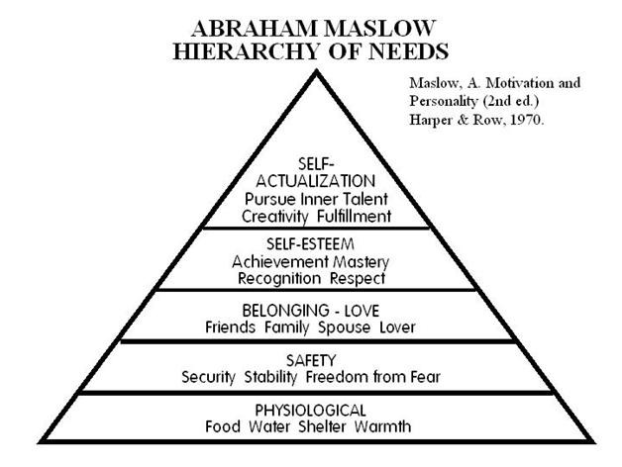
Ask about human needs. Then by displaying Maslow’s pyramid, discuss and explain how the BLOs can achieve greater self-fulfilment by working for the higher social and national cause of ensuring free and fair elections through proper maintenance of electoral rolls.
WHY SHOULD WE WORK FOR DEMOCRACY?

Slide 7
IMPORTANCE
OF MATTERS

Slide 8
The IMPORTANCE of
The ELECTORAL ROLL

Slide 9
IMPORTANCE of
The ELECTORAL ROLL
An electoral roll or voter list is an official list of persons enrolled as voters on the basis of their eligibility for such enrolment in the list of a particular area. It determines who is eligible to vote and where.
For a free and fair election, an accurate and error free electoral roll is of utmost importance.
A good e-roll is required for checking electoral malpractices like bogus voting and impersonation.
According to Article 325 of the Constitution of India, there shall be one general electoral roll for every territorial constituency for election to either House of Parliament or to the House or either House of Legislature of a State and no person shall be ineligible for inclusion in any such roll or claim to be included in any special electoral roll for any such constituency on grounds only of religion, race, caste, sex or any of them.

Slide 10
The IMPORTANCE of
QUALITY & ACCURACY of the ELECTORAL ROLL

Slide 11
IMPORTANCE of
QUALITY & ACCURACY of the ELECTORAL ROLL (1)
Accuracy and Completeness of Rolls is essential for conducting free and fair elections.
  An accurate and good quality roll is the first necessary step towards preventing electoral frauds & malpractices.
  In situations of tough electoral competition and narrow lead margins, the need to have accurate electoral rolls becomes all the more critical.
Take care - Some people may want large scale registration of bogus voters, or large-scale deletion of names of “unfriendly” voters.

Slide 12
IMPORTANCE of
QUALITY & ACCURACY of the ELECTORAL ROLL (2)
B. Correct entry in the roll entitles people to vote and assures them their right of franchise.
      It provides to a citizen,
          the fundamental sense of belonging to his nation, his state and his constituency,
          connects him to them – politically and by duty and responsibility, and
          gives him an identity and an identification in the records of the state – something of immense value and direct utility to him.
      Hence, correct entry in the roll is important for every individual voter.
As such, in the E-Roll there should not be any name unduly missing, unduly surplus (eg dead, shifted or fictitious) or duplicate. The roll should be error-free, clean & up-to-date.

Slide 13
The IMPORTANCE of
SUMMARY REVISION AS AN OPPORTUNITY
TO IMPROVE THE QUALITY & ACCURACY OF E-ROLL

Slide 14
IMPORTANCE OF
SUMMARY REVISION AS AN OPPORTUNITY
TO IMPROVE THE QUALITY & ACCURACY OF E-ROLL
Summary Revision is a Once-a-Year Opportunity.
SR entails a Targeted & Proactive approach towards
  Procedural Discipline: Receiving & disposing Claims & Objections in a decided time frame.
  Inclusion: Covering excluded sections of population, uncovered localities/colonies etc.
  Field Verification
Simultaneous Focus of DEO, ERO and their entire administrative machinery on SR leads to better outcomes.
Greater involvement of political actors and civil society (BLAs, RWAs etc.)
Time to cover the uncovered ground in advance with 1st January of the following year as the reference date.
With greater focus, stakeholder participation & coordinated action, Summary Revision is
a unique opportunity to improve the quality & accuracy of E-Rolls.

Slide 15
The IMPORTANCE of
BLOs

Slide 16
IMPORTANCE of BLO in the Revision Exercise (1)
BLO represents the ECI and steers the entire process at the cutting-edge, on the ground.
S/he is front face of the election machinery, who interacts with eligible citizens and facilitates their registration.
S/he plays a pivotal role in collecting actual field information relating to the polling area assigned to him for updating and cleaning the roll.
S/he carries out extremely important tasks like collection of photos and forms, field verification of claims and objections, distribution of EPICs etc.
Positive outcome of BLOs’ initiative is often seen in higher voter turnout.

Slide 17
IMPORTANCE of BLO in the Revision Exercise (2)
BLO is at the cutting edge in the line of accountability for an error-free roll in his part area.
BLO’s friendly and helpful approach would go a long way in boosting confidence of voters in the electoral process.
BLO forms a significant bridge between ECI & the larger public, hence, s/he is the face of the Commission to the common man.
People may never need to approach the ECI, the CEO or the DEO for roll related matters if their BLO is doing good work.
The BLO substitutes for them all when s/he works well.

Slide 18
STRUCTURE OF E-ROLL - KNOW THE COMPONENTS

Slide 19
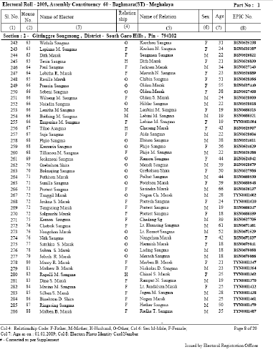
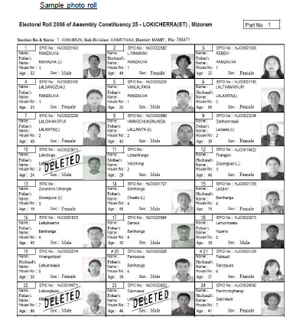
ELECTORAL ROLL
Every constituency E-Roll is divided into a number of parts. In each part there are more than one section. A section defines a clearly identifiable area/locality within that polling station area.
Text roll is then converted into photo electoral roll.
Text Roll
Photo Electoral Roll

Slide 20
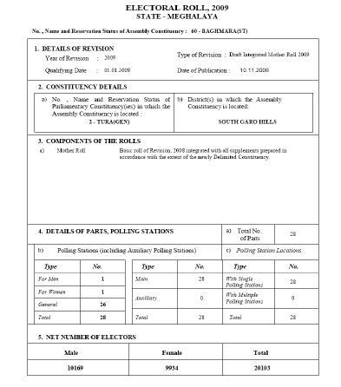
COMPONENTS
Assembly Constituency of
the State of Meghalaya
AC Title Page
The AC Title page has:
Details of the concerned Assembly constituency,
Clearly demarcated Nazari map of that assembly constituency on the back of the title page,
Details of the parts of the AC

Slide 21
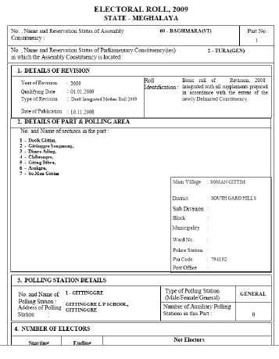
COMPONENTS
Part Areas of
the state of Meghalaya
Part Header Page
Header page has:
details of the concerned part area.
clearly demarcated Nazari map of that part area on the back of it.
Details of the sections of the part

Slide 22
COMPONENTS
Details of the sections
Details of the assembly
Section pages
This has:
name of the section on the top of the page,
details related to the concerned AC,
list of electors arranged house number wise of every section starting with one and goes horizontally,
details of electors with photo,
every section should begin with a new page.
House numbers
Electors details

Slide 23
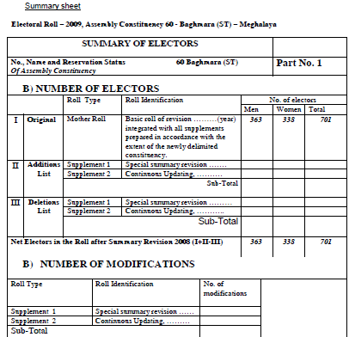
COMPONENTS
Summary of Electors
Supplement
Supplement page has:
List of names added, deleted, corrected & transposed, in the draft roll.
Addition list starting with last serial number of the mother roll,
Deletion list with no changes in the serial number and the part header,
One or more supplements can be attached with mother roll due to several revisions,
Even if no name added/deleted etc., the supplement shall be prepared indicating NIL.
Addition List
Deletion List

Slide 24
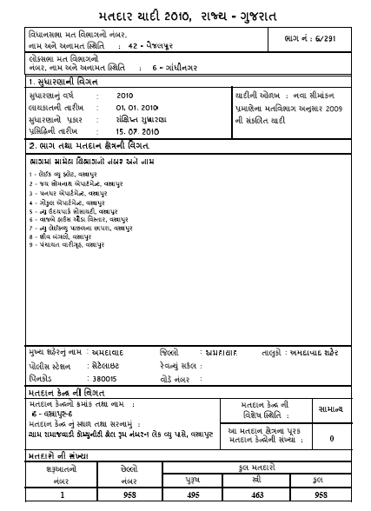
COMPONENTS
Name of PC
Name of AC
Mother Roll
It is the roll created after intensive revision and / or published as draft roll during subsequent revisions.
Any addition, deletion or changes are reflected in the supplement roll of that year.
There is provision for integration of the supplements with written prior approval of the ECI. After integration of all the supplements the roll has to be published as draft .
Details of AC

Slide 25
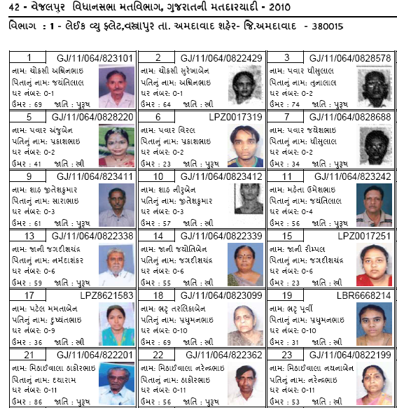
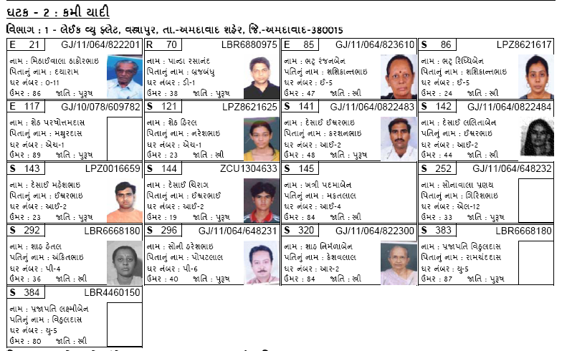
SAMPLE 1 – CHANGE DUE TO DELETION
Mother Roll
Supplement

Slide 26
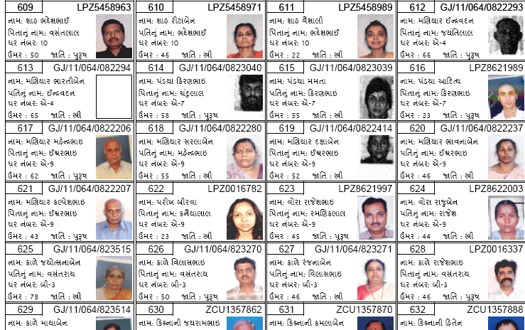
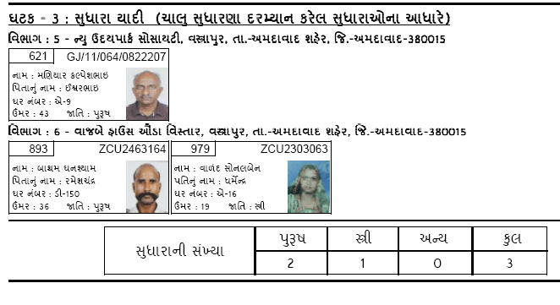
SAMPLE 2 – CHANGE DUE TO CORRECTION (INCORRECT PHOTO)
Entry in
Mother Roll
Entry in Supplement
– for change

Slide 27
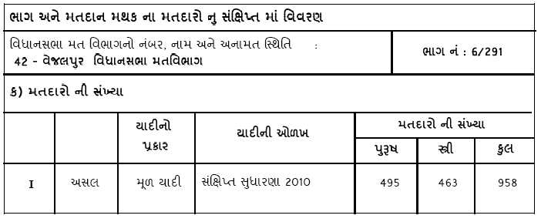
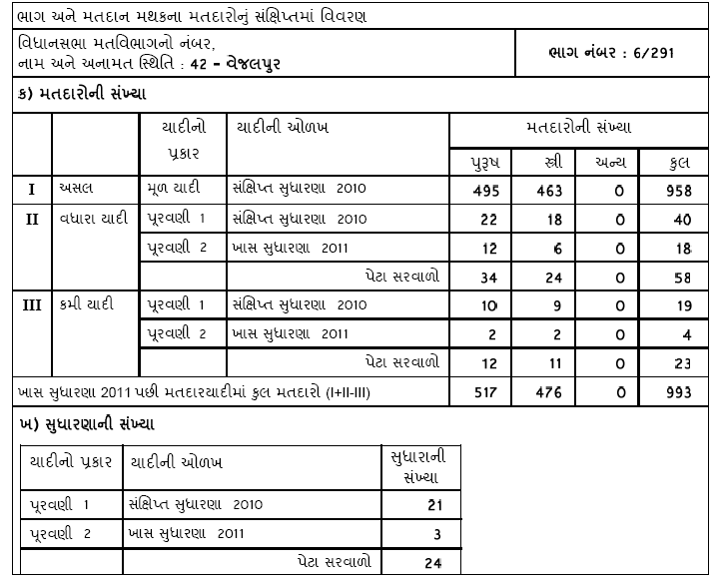
CHANGES IN THE TOTAL NUMBER OF THE ENTRIES
Entry in
Mother Roll
Entry in
Supplement

Slide 28
BLO IN ELECTORAL ROLL MANAGEMENT PROCESS

Slide 29
Who is nearest to the voter?
Election Commission of India (ECI)
Chief Electoral Officer (CEO)
District Election Officer (DEO)
Electoral Registration Officer (ERO)
Assistant Electoral Registration Officer (AERO)
BLOs Supervisor
Booth Level Officer (BLO)

Slide 30
BOOTH LEVEL OFFICER (BLO)
Who is BLO?
An important official in election hierarchy so much so that EROs/AEROs must maintain updated list of BLOs with contact details & host it on portal of CEO.
Responsible for maintaining the updated electoral roll of the assigned part area under the control & supervision of all the officers up in the previous hierarchy chart. Concept introduced in 2006.
Appointment?
Under section 13B(2) of R.P. Act,1950 – appointed by ERO with prior approval of DEO concerned,
Preferably state Govt./local authority employee,
In certain cases, retired Govt. employees too for urban areas. Central Govt. employees, if willing & only in exceptional cases.

Slide 31
BLO, THE KINGPIN
Section 13CC applies to BLOs also so they function under the control & supervision of ECI/CEO;
Each BLO is issued a special kit, photo I-card & is entitled to cash incentives/ remuneration as per prescribed rates;
Punishment for wilful default u/s 32 of RP Act 1950;
On Poll day, he is present at polling booth with voter’s slip & extends all assistance on the day.
BLO IS THE KINGPIN OF THE ELECTORAL ROLL MANAGEMENT.

Slide 32
IMPORTANCE OF THE ROLE OF BLO
A representative of ECI at the grass-root level – assists eligible citizens to become voters and obtain voter card.
Plays a pivotal role in the process of roll revision & collecting actual field information with regard to the roll corresponding to the polling area assigned to him;
Has a pronounced accountability for preparation of an error-free electoral roll.
Preparation of accurate electoral rolls & distribution of voter slips by the BLOs boost voter confidence in the credibility of the election process;
BLOs not only help in preparing error free rolls or just removing the names of Absentee, Shifted & Duplicate voters but also in maximising distribution of the election cards.

Slide 33
IMPORTANCE OF THE ROLE OF BLO
Positive outcome of BLOs’ initiative is visible in the form of accuracy in the enrolment of new voters, as well as in the increase in voter turnout;
BLO provides those different forms for addition, deletion and correction of Electoral Roll entries, carries out physical verification, & gives his/her report to Electoral Registration Officer (ERO);
BLO forms a significant bridge between ECI & the larger public, hence, they’re the face of the Commission to the common man;
So crucial, so important!

Slide 34
CASE STUDY OF BLOs’ COMMENDABLE WORK
Trainer should discuss with trainee BLOs the good work they have done. Keep a written record of their (BLOs) case studies & forward it to the respective DEO’s & CEOs.

Slide 35
CASE STUDY OF OBJECTIONABLE BEHAVIOUR
OF BLOs
Gurgaon Sting Operation in April 2014
Three BLOs were arrested for allegedly preparing fake voter identity cards in Haryana's Gurgaon district. They were purportedly shown taking bribe for preparing fake voter identity card in a sting operation.
  (http://www.hindustantimes.com/punjab/chandigarh/3-poll-officials-held-in-gurgaon-for-making-fake-voter-cards/article1-1203516.aspx)
  (http://www.gurgaonmirror.com/fir-registered-against-blos-in-gurgaon-after-fake-vote-sting/)
Group Interaction - What is your response? Your opinion? Your recommendation?

Slide 36
YOUR WORK AREA - CONSTITUENCY PARTS/POLLING STATION AREA

Slide 37
CONSTITUENCY PARTS & SECTIONS
Electoral Rolls are organized as geographically defined and compact parts,
Each Constituency Part has a number of sections,
Sections denote locality/ area details & contain household wise individual elector details,
Each Constituency part has an identified polling station location where electors cast their votes on the poll day.
Electoral Rolls of Constituency
Constituency Parts
Sections
Locality/Area
Households

Slide 38
THE PART AREA MAP
Boundary of the polling station area/constituency part area is demarcated during rationalization of polling stations,
BLO needs to know the locality/ village/ hamlet/ colony/ mohalla etc. falling in the part area & frequently visit to gather correct information about new constructions or jhuggis etc.,
Ensure new houses built in their part area are depicted in the Nazari map. Use of GIS maps from available sources including internet can help improve quality of the polling station area map (optional),
Develop local contacts in different sections of the area to remain updated about arrival of new persons, shifting of residents, death etc. in the locality . Information gathered useful for updating the roll.

Slide 39
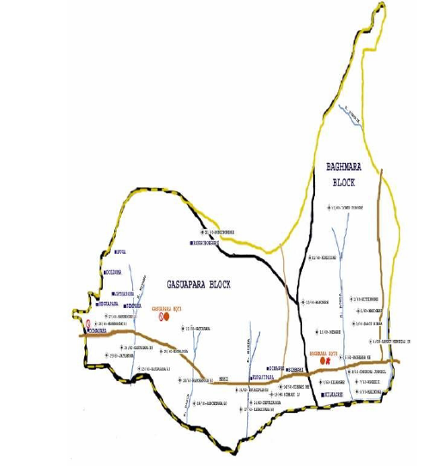
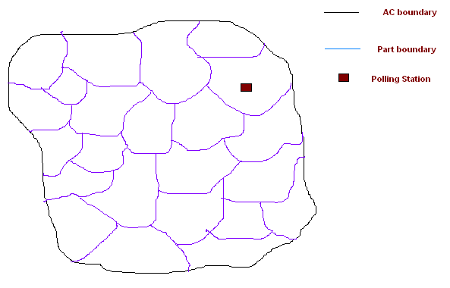
TO PREPARE CORRECT MAP BY FREE HAND EYE ESTIMATION (NAZARI MAP) OF PART AREA
Prepare Nazari map by freehand clearly indicating sections within the part. Officials from revenue may help you. Alternatively, use GIS Map.
AC Part Map

Slide 40
NUMBER HOUSES FALLING WITHIN POLLING STATION AREA/PART AREA
House numbers assigned by the Local Authorities are to be used.
In case house numbers are not assigned by local authorities, serialization of the houses should be done in ascending order beginning from North-West to South-East in zigzag manner. Every household should be assigned a number.
Acquire knowledge about the number of sections and boundaries of their part area to give correct serial numbers to the houses. If new sections need to be created , please inform the ERO so that he can do the needful.
3
1
2
6
5
4
9
7
8

Slide 41
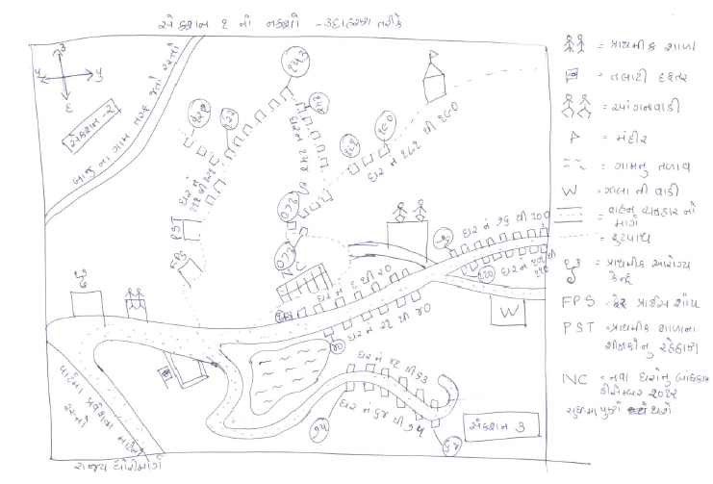
SAMPLE OF NAZARI MAP (ILLUSTRATIVE)

Slide 42
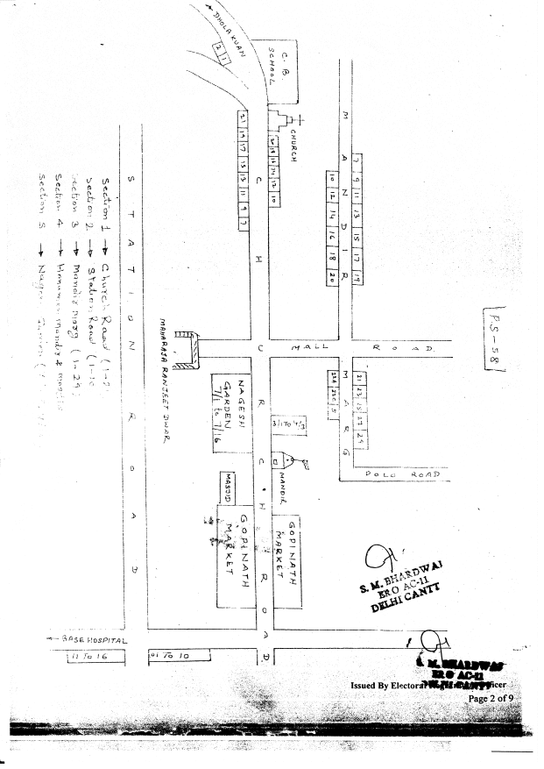
SAMPLE OF NAZARI MAP (ILLUSTRATIVE)

Slide 43
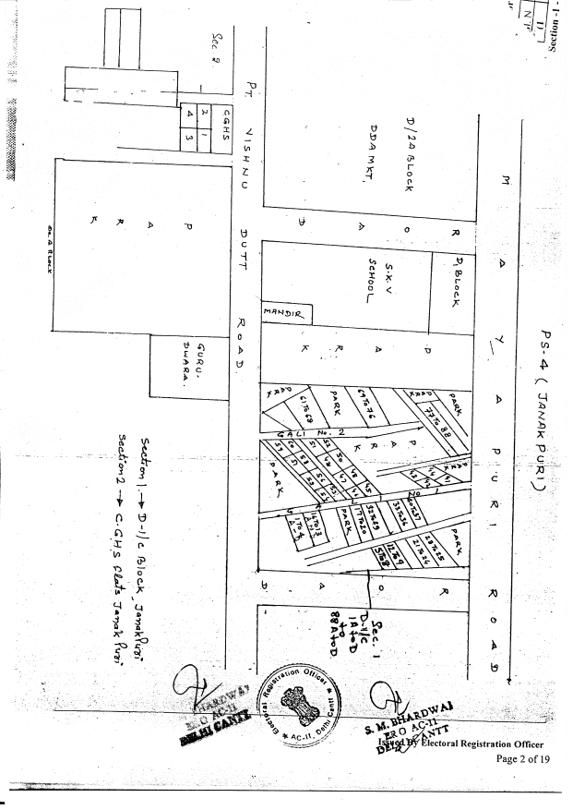
SAMPLE OF NAZARI MAP (ILLUSTRATIVE)

Slide 44

QUIZ TIME
Q. The house no. of an elector in the electoral roll and that given by the municipality is not the same. Which one to accept and use?
Q. What should be done if the name of a person, who is not ordinarily resident of that area, is included in the electoral roll and in case of the opposite situation?
Q. Where can an elector check up whether his/her name is there or not in the electoral roll? Can he do it by sending a SMS?

Slide 45
PRE-REVISION ACTIVITIES - ISSUES
Polling Station area may need rationalization,
Duplicate entry of one name at multiple places,
Many electors may not have photos in the Photo Roll.

Slide 46
VERIFICATION FOR RATIONALIZATION OF POLLING STATIONS
As and when directed by DEO/ERO/AERO, BLO shall physically verify PS in his part to check the following:-
Whether PS is situated outside polling area? Whether PS building is dilapidated/ dangerous? Whether PS is in private building/police station/hospital/dharmshala/religious place?
Whether voter is required to travel distance of more than 2 Km or has to cross river/ canal/ravine etc.?
Whether PS is in such locality where a voter belonging to a weaker section/minority community can be prevented by the dominant caste people?
Whether PS is on first floor or above? Whether room is 20 sq. mts. & has 2 doors? Whether any political party office is situated within 200 mts. from PS?
Whether building has minimum facility of electricity, toilet, drinking water, telephone & ramps for physically challenged voters?

Slide 47
VERIFICATION OF LIST OF DUPLICATE ENTRIES GENERATED BY DE-DUPLICATION SOFTWARE
ERO will identify possible duplicates using de-duplication software: the list of such duplicates will be verified by BLOs.
If on verification, a particular entry is found to be duplicate, due process of law should be followed for deleting such entry from the place where the elector is no longer ordinarily resident.

Slide 48
ERRORS TO BE VERIFIED FOR?
Part No.
Section No.
Voter relatives name
EPIC no. is less than 10 characters
ID Card No. exist but Photograph is not available
Number of sections having no voters
.......???
*Exercise - Participants should be asked to complete/list out ALL 17 errors as per the error list generated by the ECI’s ERMS software. After participants’ discussion, the trainer should give the right answers by referring to the Slide No. 112 ‘List of Errors in Electoral Roll Database’.

Slide 49
BRAINSTORMING ON INCLUSION & FACILITATION
With identification of errors, brainstorm on tendency towards NON-INCLUSION of categories such as women, other gender, service voters, floating population, pavement dwellers, migrant workers, college students, NRIs, and so forth.
Reasons should be identified & strategies should be formed to ensure better inclusion of excluded categories of population.
        For example, discuss…
        How to increase youth enrolment while not allowing underage enrolment?
        SVEEP activities & facilitation measures should be included?
        Already enrolled voters who shift their ordinary residence from one place to another – if their names get deleted from one place, awareness & facilitation measures should be taken to ensure that they re-register in the shifted place as well.

Slide 50
PHOTO COVERAGE

Slide 51
COLLECTION OF PHOTOS OF RESIDUAL VOTERS
BLO shall check roll of his/her constituency part to identify the voters who do not have image,
S/he shall visit houses of such residual voters & collect their photographs,
If BLO finds that the residual voter is not available at residence, s/he can ask the family members to send photograph by post etc.

Slide 52
ELECTOR’S PHOTO IDENTITY CARDS (EPIC)

Slide 53
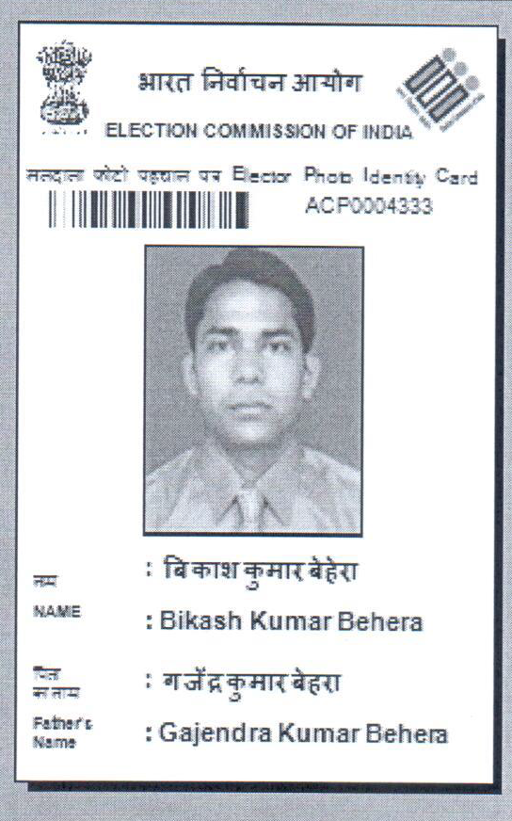
ELECTORS PHOTO IDENTITY CARD (EPIC)
Bar code
FUSN
8.6 cm
Elector’s Photo
Elector’s Name
Elector’s Father/ Mother/ Husband’s Name
Thickness - 0.6 mm to 0.8 mm

Slide 54
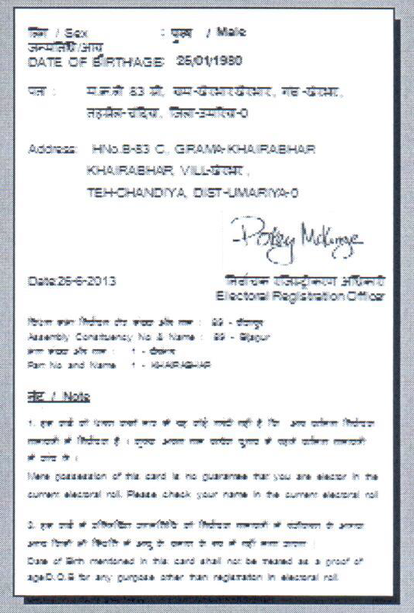
ELECTORS PHOTO IDENTITY CARD (EPIC)
Back of EPIC
Elector’s Gender
Date of Birth
Elector’s Address
EPIC Issuing Date
Number & Name of AC
EROs Signature

Slide 55
NEW PVC CARD
The Commission has introduced PVC EPIC with color photograph in place of the existing EPIC,
New PVC EPIC will be issued only to new voters or as replacement on request, otherwise the existing EPIC will continue in currency,
The specifications of PVC EPIC are as follows:-
Card Type – printed on PVC sheet of 0.6 mm to 0.8 mm thickness with color photograph.
Card size – 8.6 cm vertical and 5.4 cm horizontal with variation permissible of plus or minus 5%.

Slide 56
NEW PVC CARD
Security printing –
Front side –
Spiral micro letters line (EPIC) in art screen,
Three color guilloche design,
The National Emblem with guilloche design for invisible printing which can be seen by ultra violet light,
The National Emblem printed on the upper left hand corner and Election Commission of India logo printed on the upper right hand corner in color.
Backside –
Relief tint of “Election Commission of India” in bilingual, i.e., English & Hindi.

Slide 57

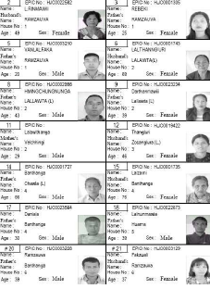
KEY POINTS
In case of change of residence EPIC issued earlier remains valid even at new place/AC;
BLOs collect electors’ photograph from:
  Onsite mode: Designated photography Location (DPL),
  Offsite Mode: Getting from Form 8,
  Getting from Form 6,
  House of electors with the help of camera teams or even using mobile phone.
Collected photographs are digitized and entered in electoral roll database;
EPIC is prepared from electoral roll database.

Slide 58
KEY POINTS
BLOs also distribute EPICs to the electors as & when directed by ERO;
Undistributed EPIC should be handed over to EROs by BLOs without fail;
BLOs should take certain actions to avoid errors in the Photo Electoral Roll:
  Thoroughly check the checklist handed over by ERO/AERO,
  Verify/ compare the copy with the manuscripts/photographs,
  Sign every verified page,
  Verify the EPIC number on roll with that on the card,
  Oversee preparation of Mother roll and Supplements from the corrected database for his/her Part,
  Attach verification certificate at end of the electoral roll.

Slide 59
RECAPITULATE
E-Roll;
Importance of the accuracy & quality of E-Roll along with the importance of the revisions;
BLOs;
Importance of the role of BLOs, Case Studies;
Map-making;
Error software and identification (list of errors) along with BLO working copy;
EPIC

Slide 60
SECOND SESSION

Slide 61
“The democracy process provides for political and social change without violence.”
- Aung San Suu Kyi

Slide 62
REVISION OF ELECTORAL ROLLS - ISSUES
Types of Electoral Roll Revision
Claims & Objections Forms
Receipt of Forms
Verification of entries
Verified forms to ERO for Disposal of Claims & Objections

Slide 63
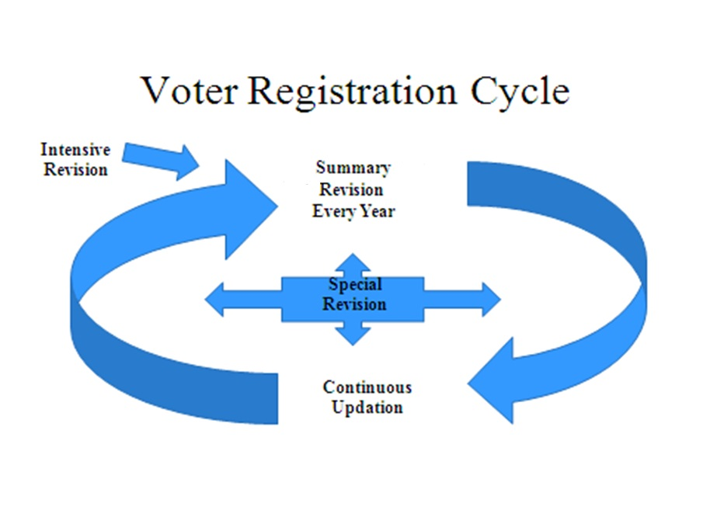
TYPES OF REVISION

Slide 64
CONTINUOUS UPDATING OF ELECTORAL ROLL
Continuous updating is
  operative from final publication to the next draft publication,
  not operative during the revision of the electoral roll,
  not operative from the last day of nominations to the end of election process.
List of entries for updating
  - should be put on the notice board every month & this requires BLOs to give updated data every month to EROs,
  - should be disposed and prepared in the manuscript in duplicate by latest 25th of next month.
EROs maintain the four separate registers for forms 6,7,8, & 8A.

Slide 65
INCLUSION OF NAMES IN THE ELECTORAL ROLL
FORM 6

Slide 66
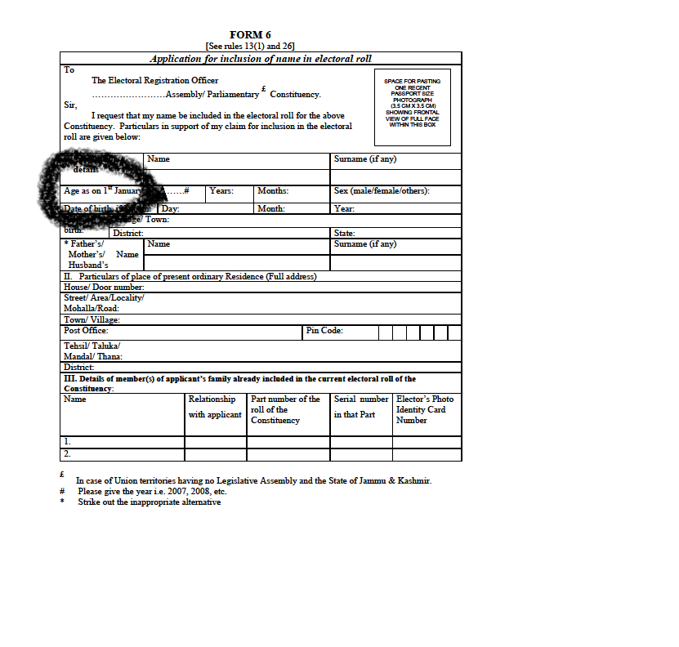
AGE PROOF

Slide 67
IMPORTANT DOCUMENTS FOR AGE PROOF
Required only for the applicant between 18 and 21 years. In case where applicant is more than 21 years and physically appears to be so, no documentary proof should be insisted on.
Either of the documents can be given -
    Birth certificate issued by Municipal Authority/Registrar of Births & Deaths or Baptism certificate; or
    Birth certificate from the school (Govt./Recognized) last attended by the applicant or any other recognized educational institution; or
    If a person in class 10 or more pass, he should give a copy of the mark sheet of class X, if it contains date of birth as a proof of date of birth; or
    Mark sheet of class 8 if it contains date of birth; or - Indian Passport; or
    PAN card; or - Driving License; or - Aadhar letter issued by UIDAI.

Slide 68
IMPORTANT DOCUMENTS FOR AGE PROOF
In case none of the above document is available a declaration made by either of the parents (by Guru in case of a transsexual category). In such case applicant will have to be present himself before BLO/AERO/ERO.
Further, if none of the above document available and neither of the parents is alive, an age certificate given by Sarpanch of concerned Gram Panchayat/by a member of concerned municipal corporation/committee can be attest.

Slide 69
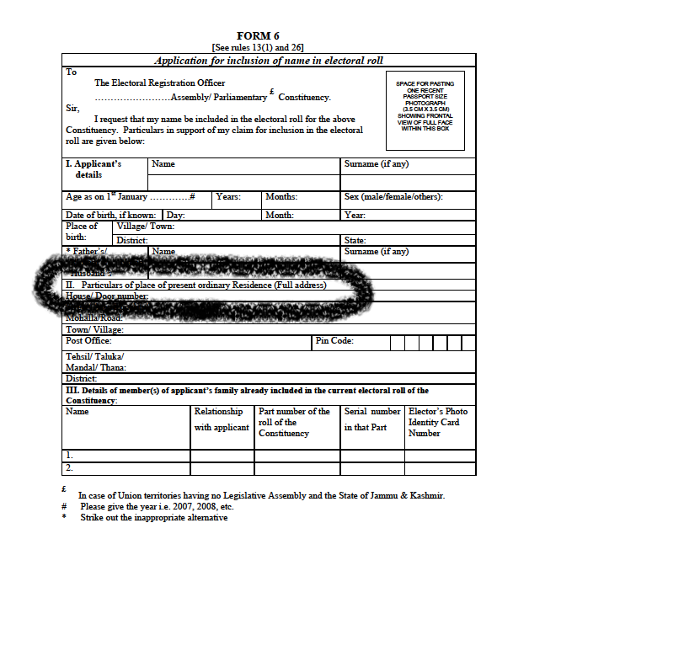
RESIDENCE PROOF

Slide 70
DOCUMENTS FOR RESIDENCE PROOF
Proof of Ordinary Residence (either of the documents can be given):-
    Bank/Kisan/Post Office current Pass Book; or
    Ration Card; or
    Passport; or
    Driving License; or
    Income Tax Assessment Order; or
    Latest rent agreement; or
    Latest Water / Telephone / Electricity / Gas Connection Bill for that address, either in the name of the applicant or that of his / her immediate relation like parents etc.; or
    Any post / letter / mail delivered through Indian Postal Department in the applicant’s name at the address of ordinary residence.

Slide 71
VERIFICATION OF ORDINARY RESIDENCE OF SPECIFIC CATEGORIES
Married woman applying for the first time
    Age Proof,
    Proof of ordinary residence before marriage and after marriage,
    - Copy of proof of marriage (Marriage Registration Certificate),
    Linkage of spouse (if he is an elector of concerned part).
Married Woman with no proof of marriage
    - It is a special case and thus ERO will have to be convinced of the marriage,
    - BLOs will have to conduct the local inquiry to ascertain the marriage.

Slide 72
VERIFICATION OF ORDINARY RESIDENCE OF SPECIFIC CATEGORIES
Homeless persons
  - BLO will visit the address given in Form 6 at night to ascertain that the applicant actually sleeps at the given address.
  - BLO must visit for more than one night for such verification.
Students staying at Hostels/places of study
    - Students have option get themselves registered as elector at their native place or at the address of place of study.
  - For verification of students applying to get enrolled at place of study, the following condition to be checked :-
Study course should be of not less than 1 year duration and be recognized by Central / State Govt. / Board / Universities / Deemed Universities.
A declaration by the student duly certified (in the prescribed format & enclosed with Guidelines of Form 6) from head of the educational institution to be attached with Form 6.

Slide 73
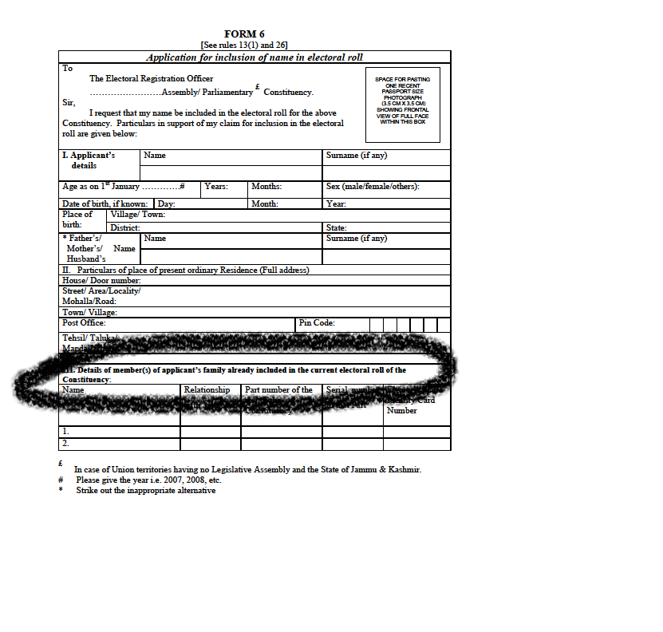
FAMILY LINKAGE

Slide 74
LINKAGE
Linkage
  - is the relationship of the applicant with one or more enrolled electors,
  - applicants name is integrated with his or her family.
If linkage is not possible
  - Electors can enrol on the basis of the following proofs:
  (i) Citizenship
  (ii) Age
  (iii) Ordinary residence

Slide 75
RECAP
“Age proof” like birth certificate, certificate from school
“Proof of Ordinary Residence” like ration card, passport etc
Age Proof
Ordinary residence proof
Parental Linkage in Electoral Roll (for citizenship issue) /citizenship proof
Students
New Voter
Inclusion (Form 6)
Married women
Shifted from other AC
Voters above 21 yrs
“Age proof”
Proof of Ordinary Residence before marriage
Marriage Registration Certificate
“proof of Ordinary Residence
Address of previous residence
Ac No.& if possible Part/Sl. No. of previous enrollment
EPIC or other citizenship evidence
Ordinary residence
Declaration as to delayed registration (age > 21 yrs) (Part 4 of form 6)
Ordinary residence

Slide 76
OTHER FORMS:
OVERSEAS ELECTORS (Form 6A),
DELETION (Form 7),
TRANSPOSITION WITHIN AC (Form 8A)
& MODIFICATION (Form 8)

Slide 77
New registration
Enrolment of Overseas
Voters (Form 6A)
Passport copy
BLO may be asked to verify & report
Form to be sent to ERO by post or personally
Correction (Form 7)
Objections
Justification

Slide 78
Part & Sl. No. of previous enrollment
Transposition/change of
address within constituency
(Form 8A)
EPIC
Ordinary residence
Correction (Form 8)
Part & Sl. No. of enrollment
Evidence in favor of correction sought for

Slide 79
ENROLLMENT OF OVERSEAS ELECTORS
An overseas elector is
  an Indian citizen absent from his place of ordinary residence in India due to employment, education or otherwise,
  has neither included his name in electoral roll nor has acquired citizenship of any other country.
S/he can register the name in the electoral roll from the part area mentioned in his/her passport.
Any overseas elector who has completed the age of 18 years can submit his application form 6A either in person or by post to the concerned AERO/ERO of the residential area mentioned in his passport.

Slide 80
ENROLMENT OF OVERSEAS ELECTORS (CONTD.)
Role of BLOs
  During H2H visit he enquires if any family member is abroad. If so give the Form 6A with a request to family head to send the form to them so that they can become overseas electors in India. [Since form 6A is also available online, information may be given for downloading it also]
On instruction from ERO, verify the self attested copies sent by the applicant
No EPIC to overseas electors
The electors overseas are not issued EPIC but use their passport for their identification to caste a vote.

Slide 81
WHO ARE SERVICE VOTERS?
Persons belonging to any of the following categories have ‘Service’ qualification & are referred to as Service voters:
  A member of armed forces of India,
  A member of force under the provisions of the Army Act, 1950,
  A member of an Armed Police Force of State who is serving outside that State,
  Employed under the Government of India in a post outside India,
  Wife of any members mentioned above who is ordinarily residing with him.

Slide 82
ENROLMENT OF SERVICE VOTERS
Form 2, 2A and 3 for three different categories are filled to become a Service Voter,
Forms are submitted at his designated Record Office or to his superior authority,
These forms are sent to EROs for registering as service voter,
Not mandatory to be registered as service voter for every person who has Service Qualification,
He can enrol himself as ordinary voter,
A service voter can either register as service voter or an ordinary voter. Registering at both places is an offence.
BLO’s role comes when
- when a service voter decides to register as a general voter,
- His/her family members who are not service voters want to register.

Slide 83
ROLE OF BLO WITH REGARD TO SERVICE VOTERS
Take action for getting the Form 6 filled wherever necessary,
Ascertain that person with service qualification have been staying at place of residence for sufficient span of time to register him as ordinary voter,
Facilitate to fill form 6 for the eligible family members of all service voters eligible to be registered as general electors,
Fill form 6 for the husband of a service voter to be registered as ordinary voter,
Wife of service voter has a choice to either be registered as service voter or ordinary voter,
BLOs should make necessary visits within their areas for the above purposes.

Slide 84
ENROLMENT OF ORPHANS
Eligible orphan in orphanage can be enrolled by registering his orphanage name in place of his parents.
Eligible orphan brought up by a family can be enrolled by entering name of orphanage.
Eligible orphan legally adopted by family can be enrolled by entering his adopted father/mother’s name.
Any orphan not covered under above mentioned categories can be enrolled by entering “Known” by BLO.

Slide 85
PROCEDURE OF RECEIVING CLAIMS & OBJECTIONS
Acknowledgment/receipt should be given for each application of claim/objection received by BLO,
Any claim/objection can be given/sent to ERO by post or in person to BLO,
Claims/objections given in bulk by person or post not accepted,
Claims of all members of one family can be received for registration of names in electoral roll from any one member of the family,
Inaccurately filled or incomplete application should be got corrected & completed by BLOs before receiving,
For special campaign days, BLOs (where they are not designated officers) should be present in addition to the designated officers at PSs,
Designated Officers/BLOs will maintain lists (in duplicate) in Forms 9, 10, 11 and 11A for applications received in Form 6,7,8, 8A respectively,

Slide 86
PROCEDURE OF RECEIVING CLAIMS & OBJECTIONS
Designated Officers/BLOs write their findings with regard to age/ address/ other particulars on the applications received for claims/objections before sending them to AEROs/EROs,
BLO writes comments on records submitted by the applicants for proof of age,
Hearing on application of claim/objections commences after being exhibited in form 9, 10, 11 and 11A for 7 days - Rule 16 (b), RER 1960,
ERO specifies date, time and place of hearing of claim/objection in the list.

Slide 87
FINALIZATION OF E - ROLL AFTER DISPOSAL OF CLAIMS & OBJECTIONS SUBSEQUENT TO DRAFT PUBLICATION
Electoral roll should be amended for any mistakes/errors in sections or details of other table,
Map of Part area or legislative assembly constituency should be amended,
Preparation of first supplementary:
  Handwritten manuscript for additions, deletions and corrections,
  Section wise manuscript for additions,
  Section wise supplementary list of deletions and corrections is not necessary,
  Certified handwritten manuscript by ERO from which the data should be entered,
  Verification by BLO, of checklist printed after the entry of data,
  Verification by BLO, of photo checklist also,
  Publication of draft roll.

Slide 88
FINAL PUBLICATION OF E - ROLL AFTER DISPOSAL OF CLAIMS & OBJECTIONS
Final publication of e - roll is completed with list of amendments in form 60 in the office of ERO under rule 22 of RER 1960
Final publication of e - roll also gets published on website of CEO as directed by ECI. Also displayed on the PS for public inspection for a period of 7 days.
No publications on public holiday

Slide 89
THE BLO KIT

Slide 90
BLO’s Kit
Each BLO is issued a KIT containing a bag on which logo of the Election Commission of India is printed. The BLO Kit should have the following items :-
      1. The Electoral Roll of his part area
      2. His BLO Register (in prescribed format, pre-printed)
      3. BLO’s identity card
      4. A copy of BLO’s Handbook
      5. Sufficient number of blank Forms 6, 6A,7, 8 and 8A
      6. Working Copy of the E-Roll (when needed)
      7. Reports like error reports of the roll of his part area (when available)
      8. Writing pad with sufficient papers
      9. Blank Register
      10. Pen, Pencil, eraser, ruler

Slide 91
MOCK EXERCISE ON FILLING OF FORMS
All the BLOs MUST bring their kits to the training, along with blank copies of all Forms (6, 6A, 7, 8, 8A). (If BLOs don’t have Forms, then the trainer shall provide blank forms to the BLOs at the time of training).
Each trainee BLO should take one form of each type and cancel them at the start by writing the words ‘Dummy & Cancelled’ across them (so that they do not mix up with actual forms at any time).
Mock Exercise – Practice of Filling these Forms - The trainee BLOs should fill one form of each type with dummy data/ information in front of the trainer during this session.
Any uncertainty/query/doubt should be addressed by the trainer, thereby ensuring that the BLOs are thorough about how these forms are to be filled.
Destroy these forms at the end of training.

Slide 92
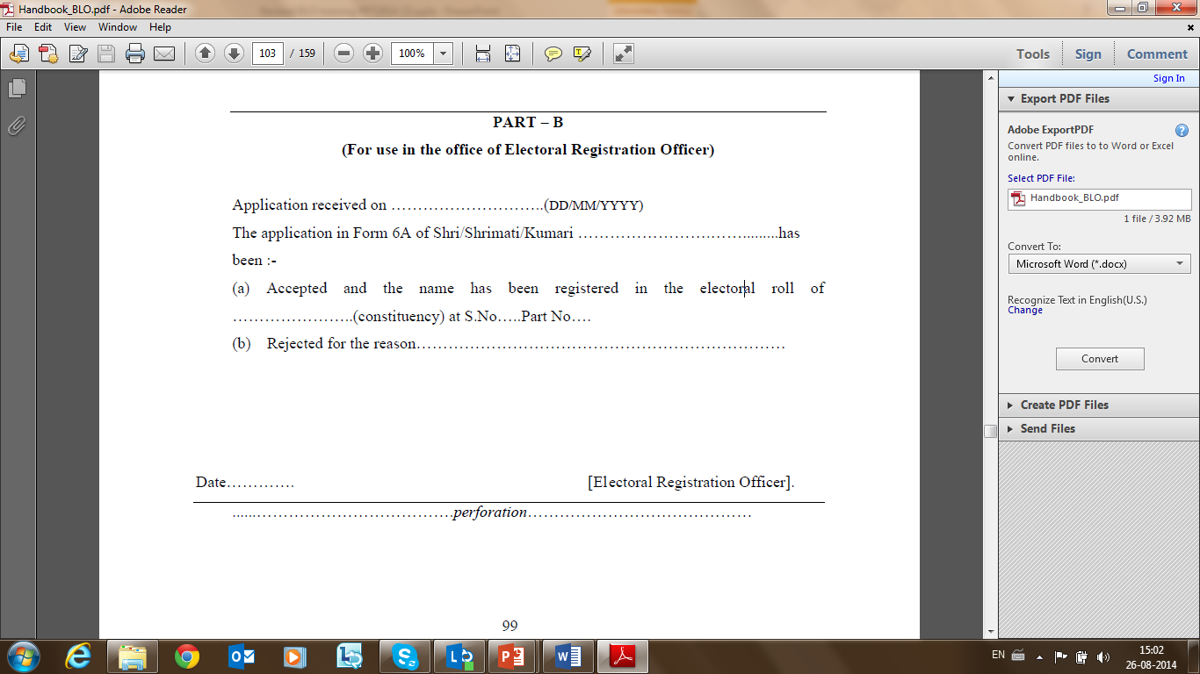
MOCK EXERCISE ON FILLING OF FORMS
*Special emphasis should be laid on Part B of Form 6.

Slide 93
PHYSICAL VERIFICATION OF THE ROLL
As and when directed, using BLO register, a BLO needs to do physical verification of the roll of the part assigned to him/her through house/ field visits,
During the visit, by asking questions to family members, BLOs verify the entries, correct the same if incorrect, collect the photo of residual electors/unclear photos, note down EPIC nos., if already issued but not reflected in relevant column, note down the names of eligible persons but not included, electors found dead, shifted, duplicate etc., ask if any family member is in foreign country, give blank appropriate forms and assist in filling them etc.

Slide 94
RECAPITULATE
Types of Revision
Inclusion of Names in the Electoral Roll
Documents
Verification
Forms
Procedure of receiving Claims & Objections
Practical form-filling exercise

Slide 95
THIRD SESSION

Slide 96
“Knowing is not enough; we must apply. Willing is not enough; we must do.”
- Johann Wolfgang von Goethe

Slide 97
ROLE PLAY

Slide 98
ROLE PLAY
ON HOW THE BLO SHOULD DO FIELD/ HOUSE VERIFICATION
OF THE ENTRIES IN THE ROLL AND OF CLAIMS & OBJECTIONS
  Participants should be asked to play the role of each of these characters and a discussion should be facilitated on how they should ask different questions in different situations so as to find reasonable answers in a friendly, efficient and professional manner.
  BLOs
  Father/Mother, Husband, …
  Children aged 15 – 17 years
  A person who has just turned 18 years
  Pavement dweller
  Newly married bride who has just come to her in-laws house
  Recently employed who has just migrated
  Tenant
  Migrant Labour (agricultural/ industrial labour)t PG Student who has just come to live in hostel
  Family member of a person who has just migrated out for work or study
  Family member of a person staying abroad
  Transgender
  Any person out of the ASD list.

Slide 99
QUESTIONS TO BE ASKED DURING
H2H VERIFICATION
Is the section address correct?
Is the Pin Code number correct?
Whether elector's photo image is correct? (If it is wrong or not available the correct photo is to be collected)
Whether the EPIC number is correct? (This is to be verified from the actual EPIC)
Whether elector's birth date is shown? If not shown what is the correct birth date? If birth date is not available, what is the approximate age (verify birth date with evidence and if not verifiable the “birth date” column should be left blank)
Whether the house number given by civic bodies is correctly noted? If no house number has been given by urban local body then it need not be verified.

Slide 100
QUESTIONS TO BE ASKED DURING
H2H VERIFICATION
7. Whether the spelling of the name of the elector is correct in name of official language of the state? Whether the English spelling of the name of the elector is correct?
8. Whether the relationship mentioned in the roll is correct?
9. Whether the gender is correct?
10. Whether the age is correct as on qualifying date?
11. Whether any names or all of the names of any/all family members have been repeated in the part roll?
  12. Is there any member of the family who has turned 18 years on qualifying date and is yet to be enrolled? (Give Form-6 and note in Annexure-II of the BLO register).

Slide 101
QUESTIONS TO BE ASKED DURING
H2H VERIFICATION
13. Is there any member of the family who has recently joined this household on the grounds of marriage, employment, tenant etc.? (Give Form 6 and note in Annexure-II).
14. What is the total number of members of the family including voters and non-voters residing in the household?
15. Out of the total family members residing in the household (including voters and non-voters) how many are male and how many female?
16. Are there any new societies, public building, public areas that have come up since the last revision of rolls in the knowledge of the voter? If yes, check whether there are voters living there, if yes then Form No.6 or Form No. 8A as required may be given and details noted in Annexure-II.
17. If any member of the family is abroad, note down the particulars and give them Form 6 A with a request to them that they should send it to their relatives to become overseas electors.

Slide 102
IMPORTANCE OF PROCEDURAL & LEGAL DISCIPLINE

Slide 103
IMPORTANCE OF PROCEDURAL & LEGAL DISCIPLINE
Following proper channels of procedures provide clear and transparent structures for dealing with difficulties which may arise from an unforeseeable circumstance.
BLOs must follow disciplined procedures which are necessary to ensure that everybody is treated in the same way in similar circumstances, to deal with issues fairly and reasonably, and ensure that BLOs are compliant with current legislation and legal mandate.
identify obstacles to voters for registering in the required standards (for ex. lack of clarity, additional support needed) and enable voters to take appropriate action.
Provide voters with complete honesty a course of action if they have a complaint.
provide points of contact and timescales to resolve issues of concern.
BLOs must hand over all forms, documents, photos etc. collected from public to the EROs/AEROs without delay.

Slide 104
IMPORTANCE OF PROCEDURAL & LEGAL DISCIPLINE
Should abide by & function as per the guidelines & legalities laid down by the Commission and the Constitution.
House visits/field verification must be diligently done by BLOs when required.
Extreme care should be taken to avoid wrong deletions & bulk additions/deletions.
All pre-revision activities should be scrupulously undertaken, and proper care should be taken in detection, field verification & removal of duplicates or any other errors.
Systematic action should be taken for very young/old/migratory/shifting/ASD list voters.
As face of the Commission, BLOs should maintain high ethical/moral principles & standard while functioning on the field i.e., not adhering to corrupt practices, for ex. Gurgaon case.
BLOs should bear certain quality of communication while engaging with people i.e., professionalism, politeness, clarity, approachability and at the same time.

Slide 105
BLO REGISTER
AND
CHECKLIST

Slide 106
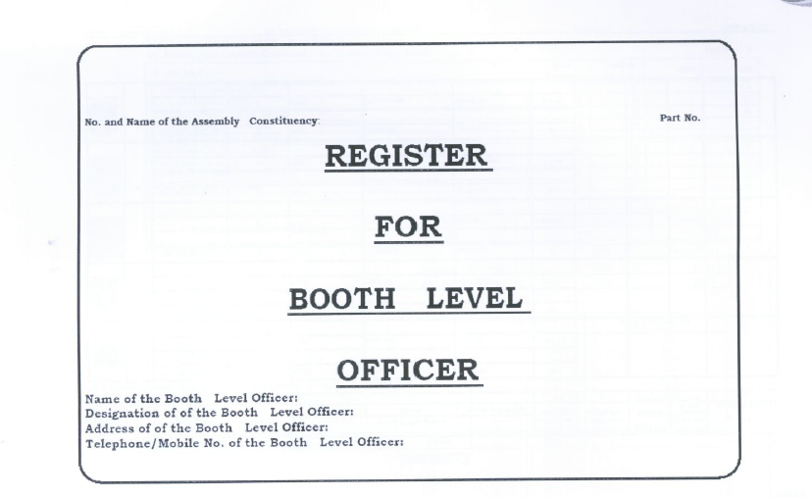
COVER PAGE OF BLO REGISTER

Slide 107
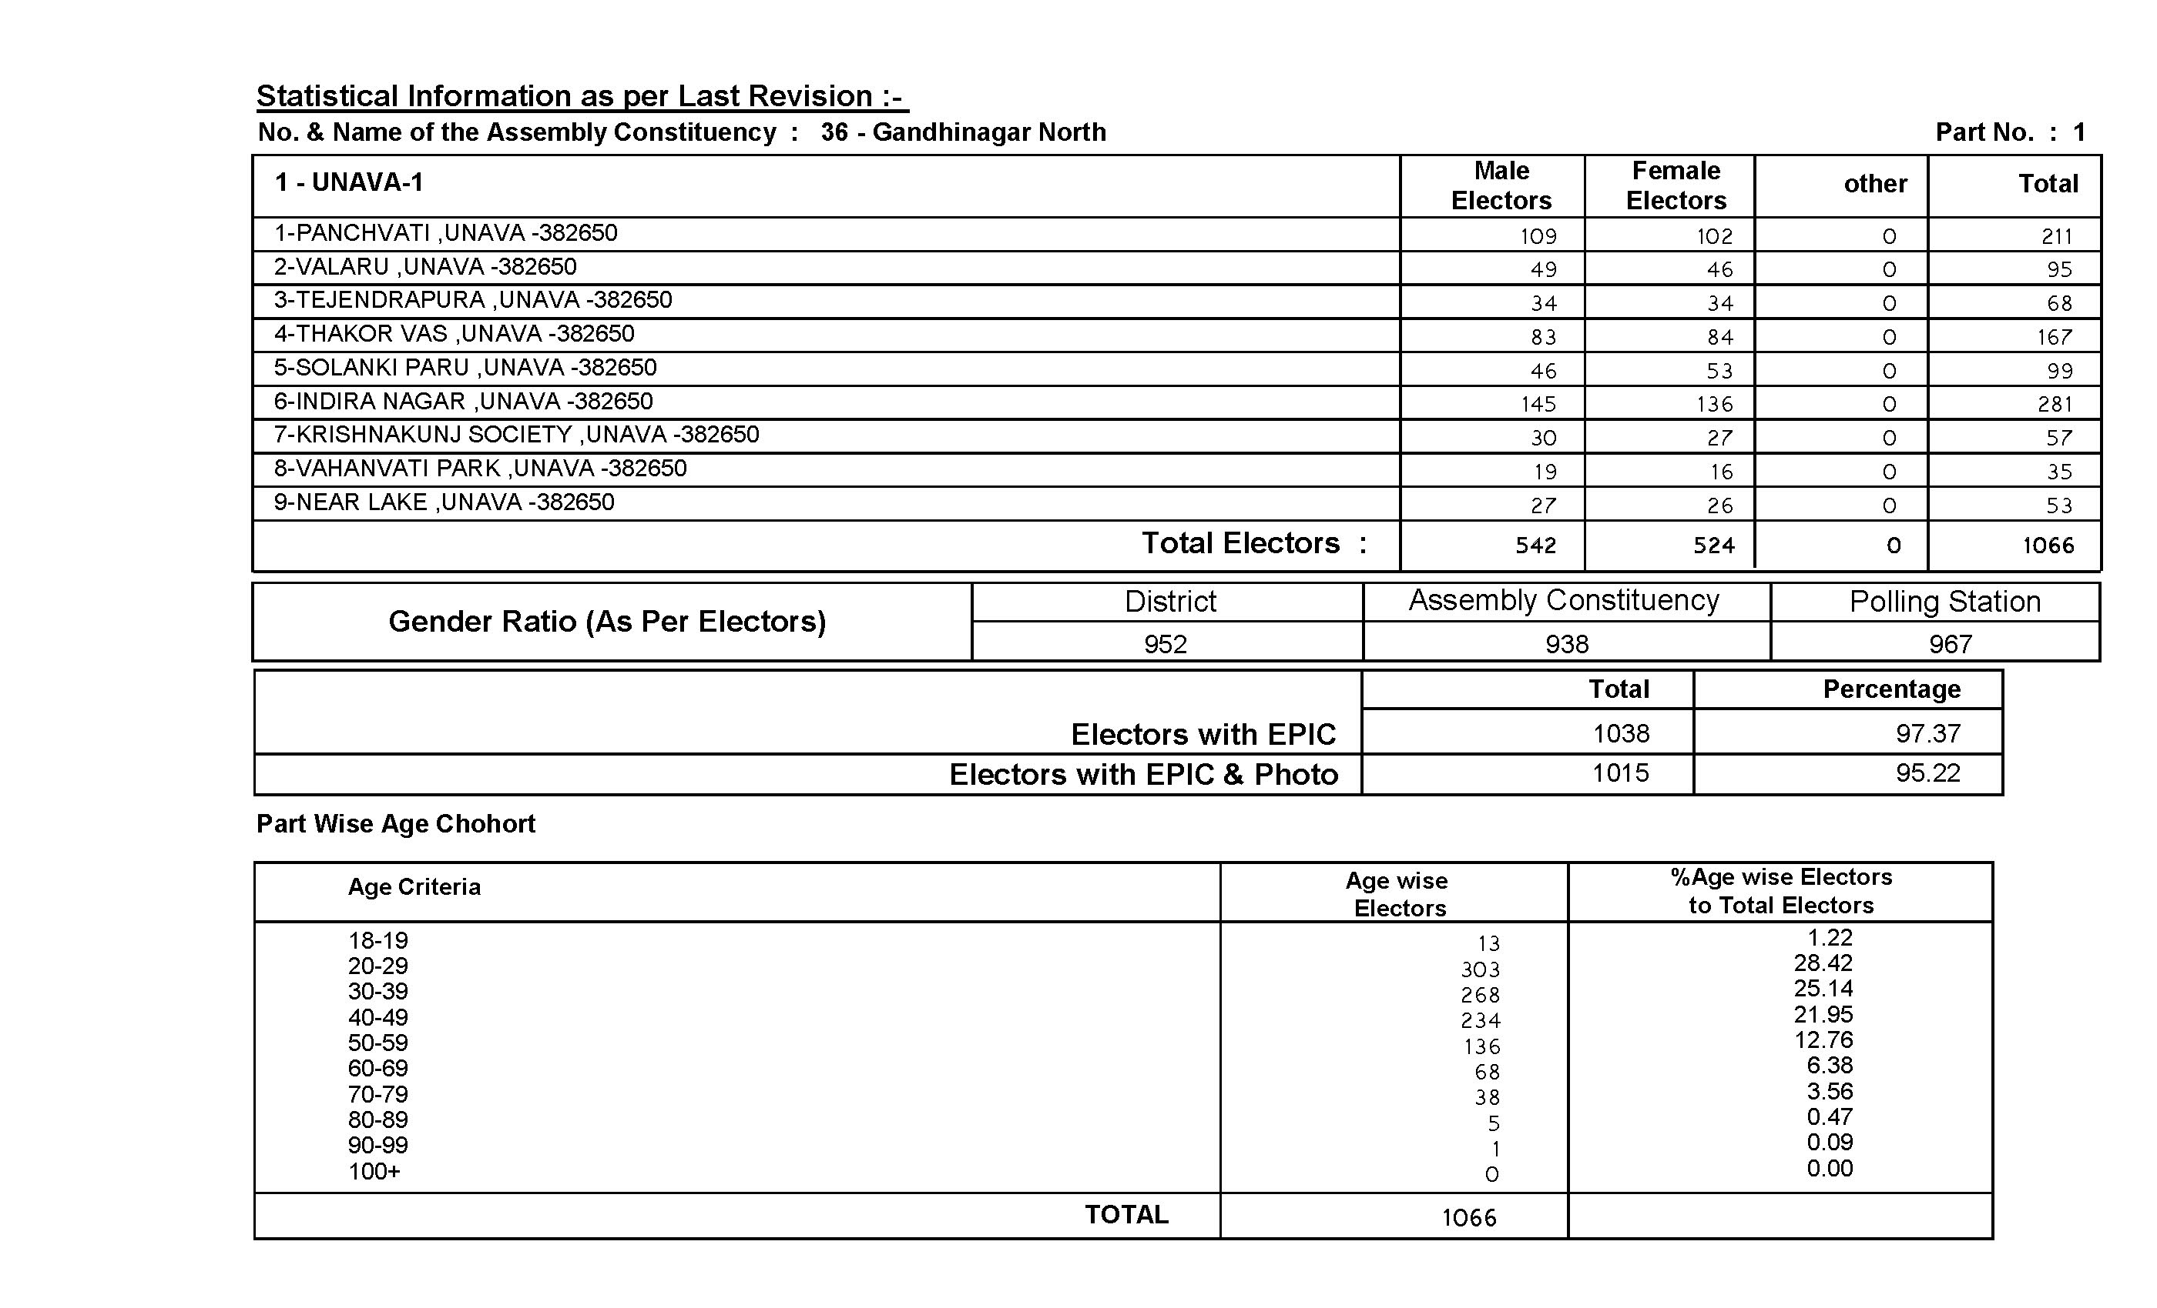

Slide 108
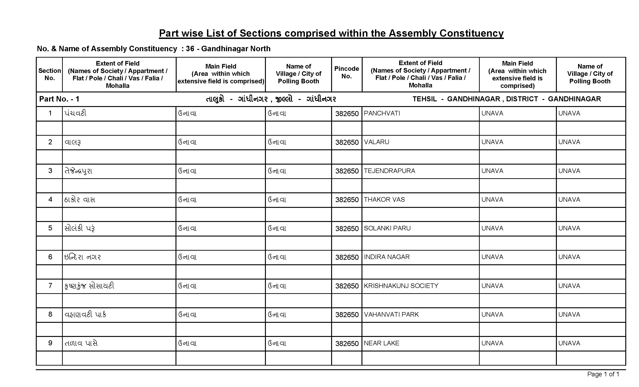

Slide 109
BLO REGISTER
BLO Register helps keep the Electoral Rolls updated & error free. BLO Register is to be updated and completed every year before Revision of Rolls.
BLO register comprises of two parts:
Annexure – 1
BLO can make corrections to confirm the existing entries of electors which are listed household wise,
In addition, birth date and telephone numbers are taken.

Slide 110
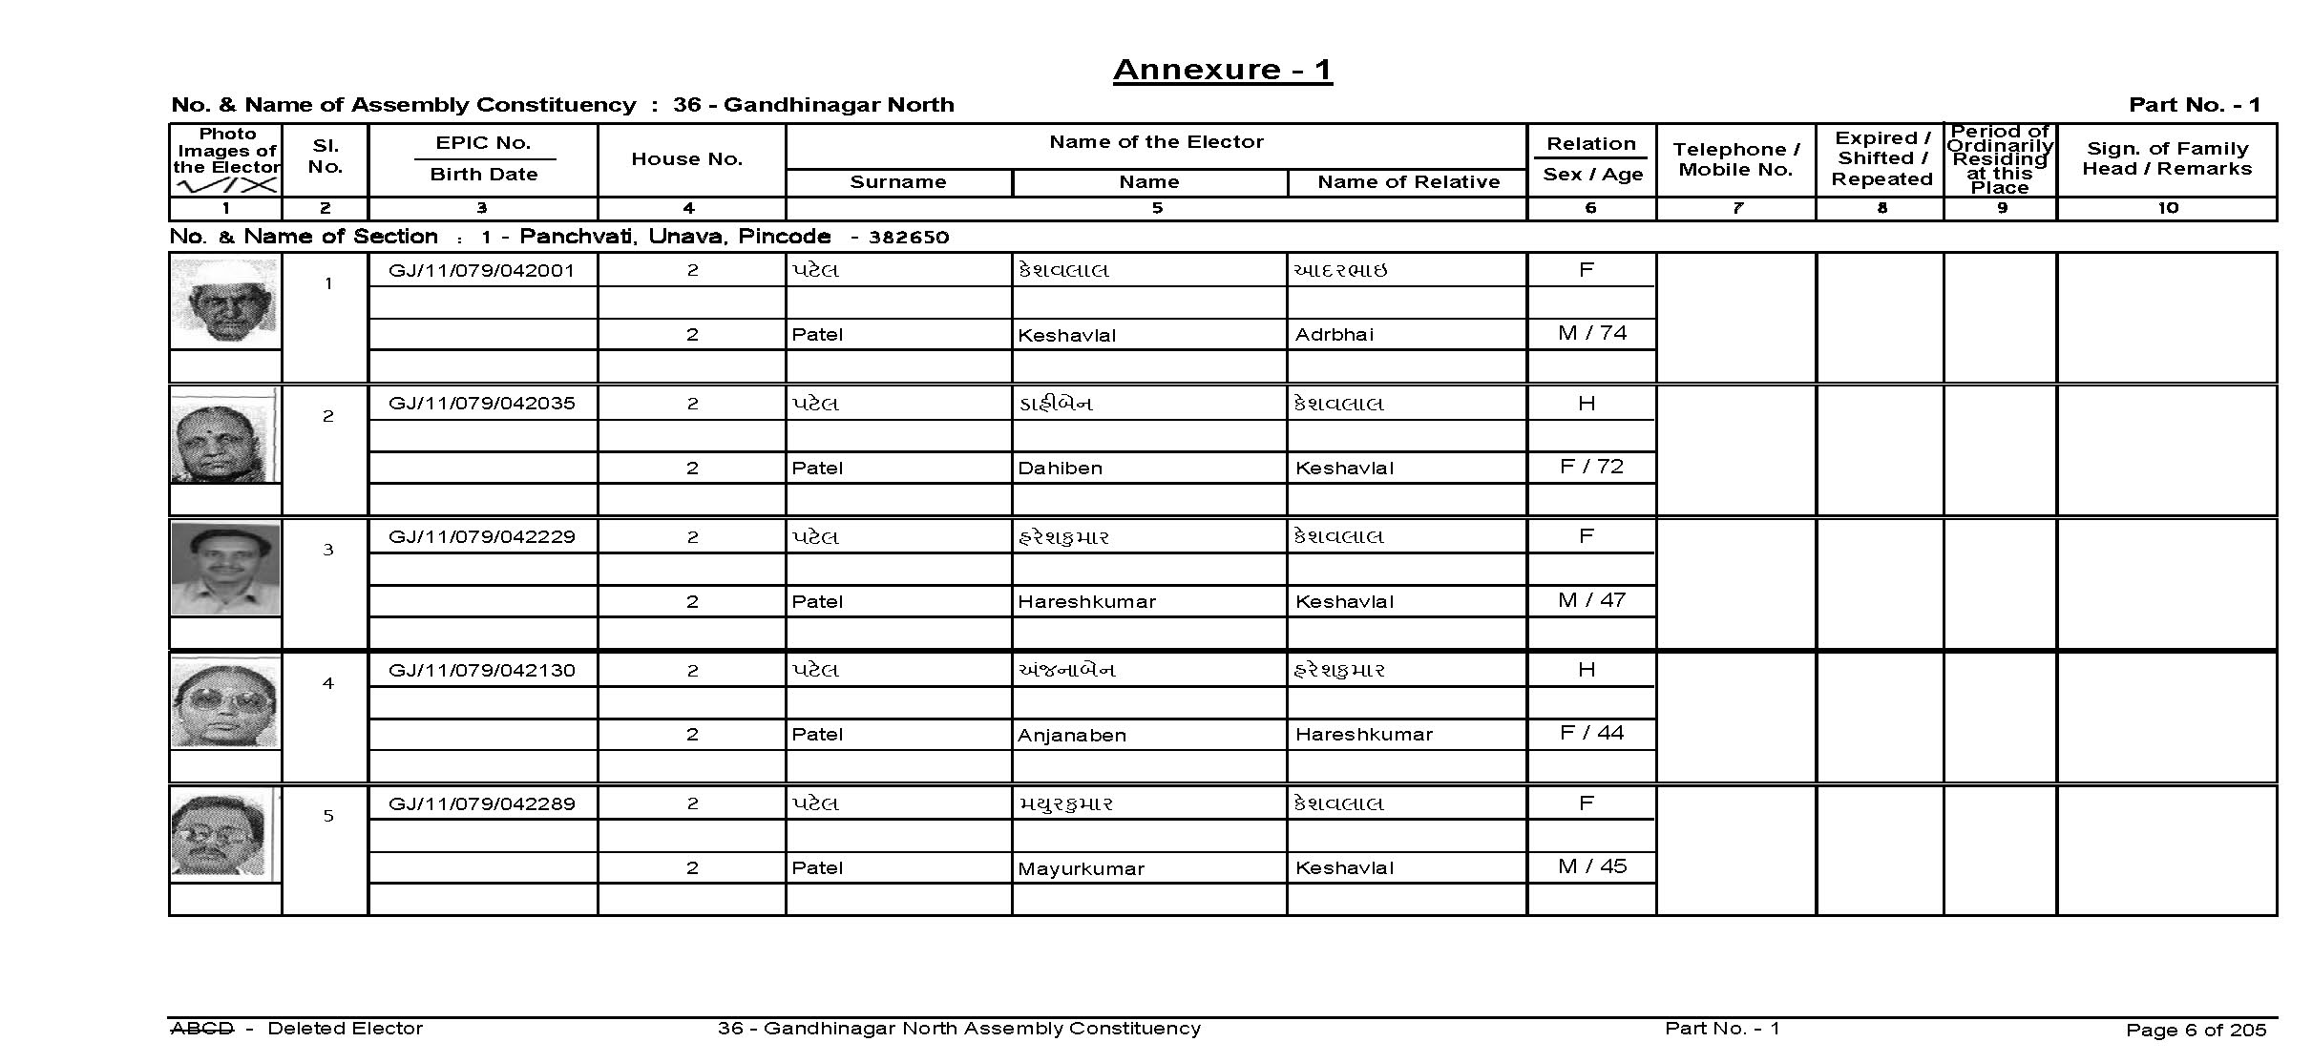
ANNEXURE 1

Slide 111
BLO REGISTER
Annexure – 2
Newly developed and under construction areas/societies/apartments etc. is entered here,
Newly arrived/ newly eligible/left out electors of that part are entered here,
Household wise, population (total of voters and non-voters) and gender ratio of that part are entered here.

Slide 112
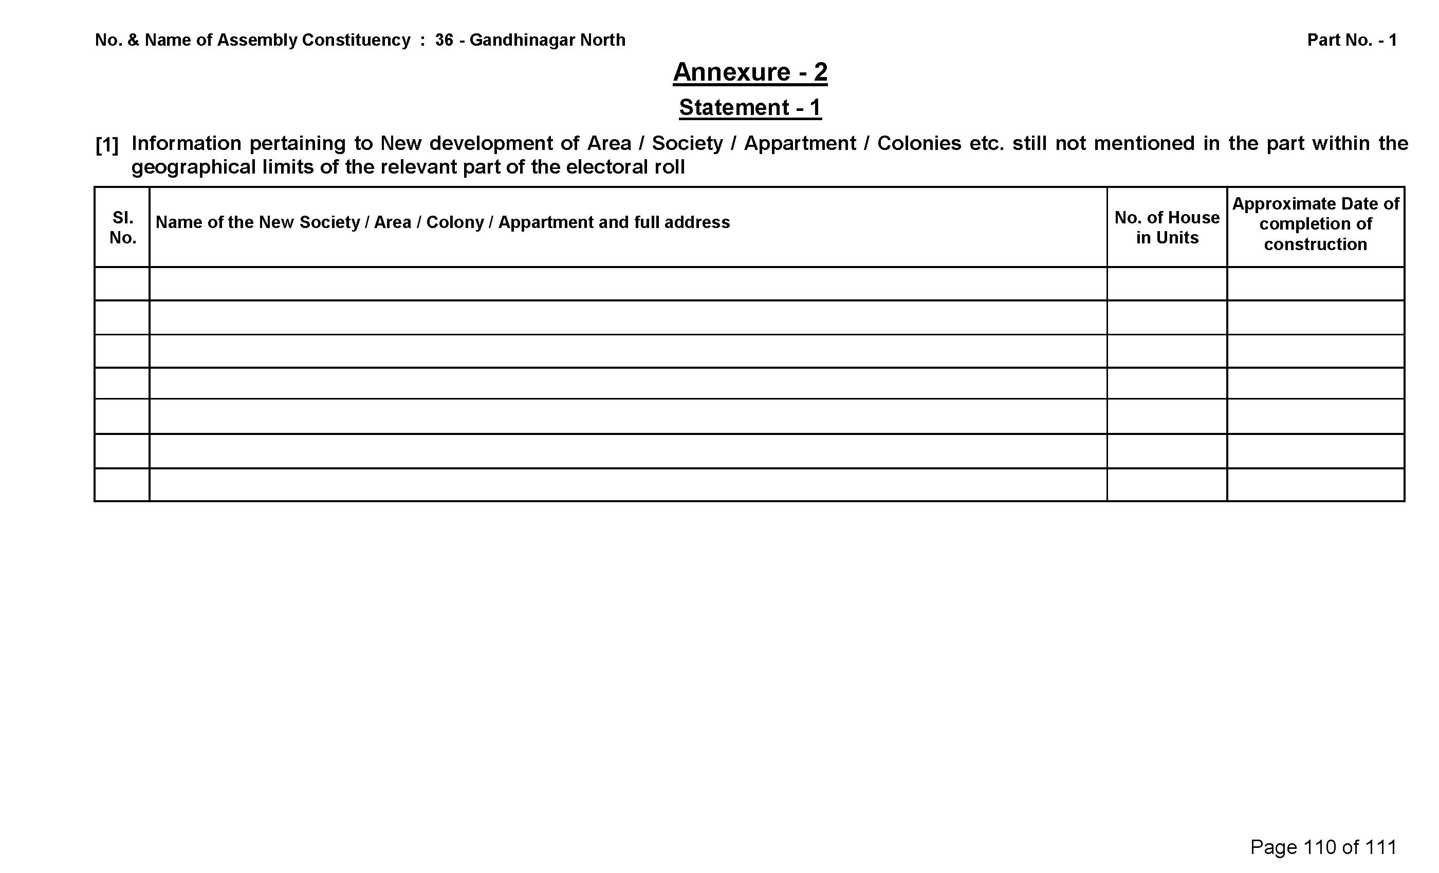
ANNEXURE 2
1. Newly developed areas/societies/apartments

Slide 113
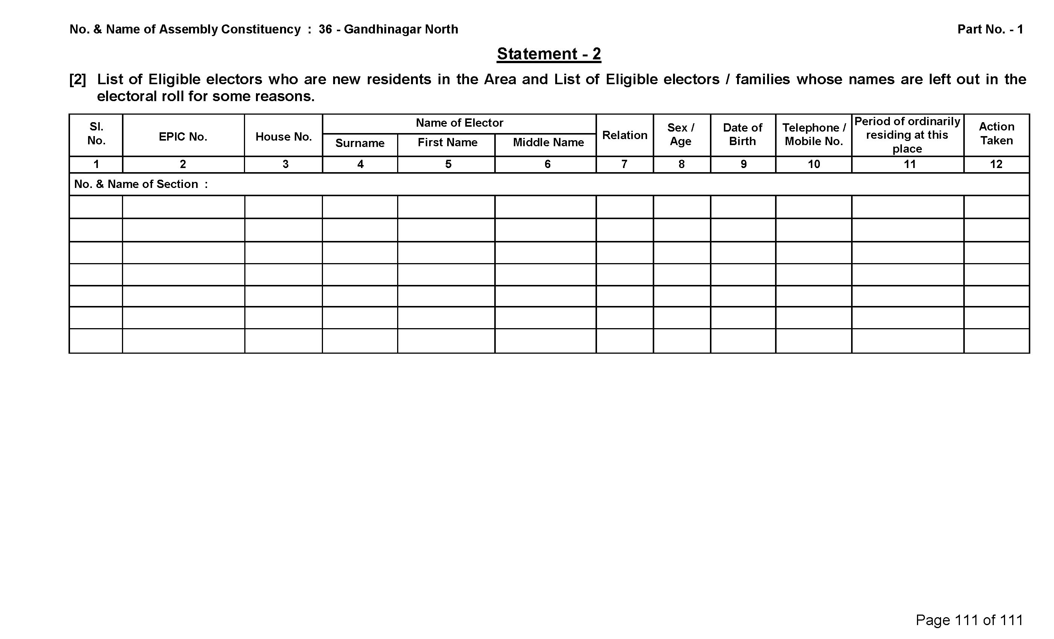
ANNEXURE 2
2. Newly arrived eligible electors

Slide 114
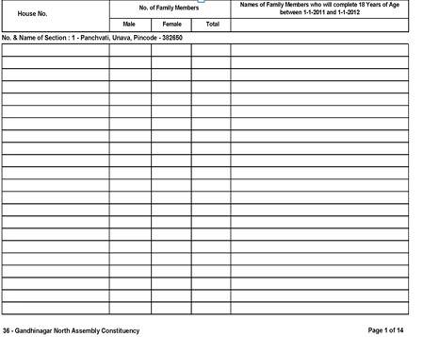
ANNEXURE 2
3. POPULATION AND GENDER RATIO OF THAT PART
Total number of households in this Part

Slide 115
ADVANTAGES OF BLO REGISTER
A continuous record for statistical analysis of the roll
Can be used to examine the health of roll at any point of time
Can be used for keeping track of development of new colonies and migration
Can be used for cleansing of the roll in terms of expired, shifted and duplicate electors
An error-free & pure electoral roll can be prepared with ease & comfort during the revision as details of would-be electors, electors who are no more eligible for various reasons like shifting, expiry etc. are readily available at any point of time

Slide 116
HEALTH ANALYSIS OF THE ROLL
BY THE BLO

Slide 117
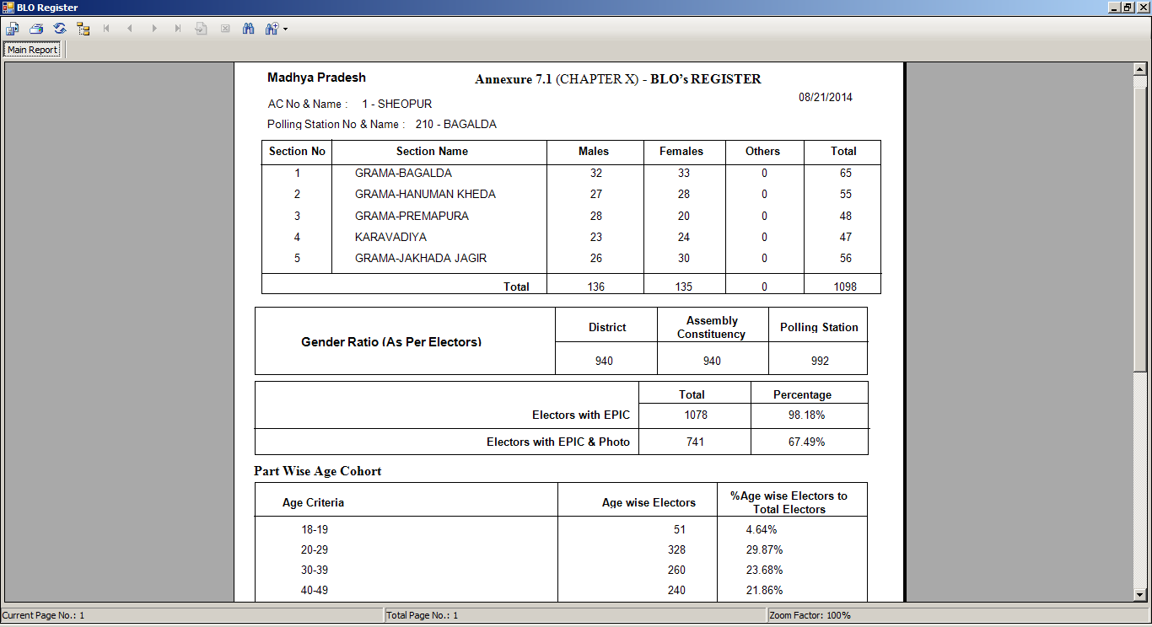
See Annexure 7.1 (Chapter X) of the BLO Register on the side.
It summarizes the broad parameters of the roll of a Polling Station.
Bring this pre-filled to the training for the PS of each trainee BLO.
The Trainer should obtain prints of PS-wise filled-in Annexures 7.1 from the ERO or the DEO for every trainee BLO in the batch. (DEO or ERO would generate and print it from the ERMS in advance). [Ref. ECI Circular no. 485/Comp/ERMS/2014 dated 26-8-2014]
Otherwise, each BLO should fill it in advance and bring it to the training.
HEALTH ANALYSIS

Slide 118
HEALTH ANALYSIS
During the Training by BLOs
(1)
Each BLO should analyse the following types of points using the filled-in Annexure 7.1 of the BLO Register for the E-Roll of his Part Area during the training itself:
    How does the Gender Ratio of the PS compare with that of the AC and the district. Find reasons for wide differences and deviations, if any.
    Is the percentage of any age-cohort much higher/ lower than expected. Compare with fellow trainees. Figure out possible reasons for deviations.
    …
Trainers should encourage analytical and focused discussions on such points.

Slide 119
HEALTH ANALYSIS
During the Training by BLOs
(2)
Each BLO should analyse the following types of points using the filled-in Annexure 7.1 of the BLO Register for the E-Roll of his Part Area during the training itself:
    ..
    ..
    If the % voters in age-cohorts 20-30, 30-40 are too low or too high, should you not track the working age population for migration and young women for marriage etc.?
      Do you have in-migration or out-migration of agricultural labour, industrial labour or students in your part area?
      Are there any new colonies or habitations coming up in your area or getting removed from your area?
      Are there new or expanding industrial units in your area?
      Are there a lot of agricultural landowners in your area who employ labour?
      Are there colleges or hostels in your area?
    …
Trainers should encourage analytical and focused discussions on such points.

Slide 120
HEALTH ANALYSIS
During the Training by BLOs
(3)
Each BLO should analyse the following types of points using the filled-in Annexure 7.1 of the BLO Register for the E-Roll of his Part Area during the training itself:
    …
    ...
    …
    Should you not track the enrolled senior citizens (age-cohorts 60-70, 70-80, and above) about being alive if the % in these age-cohorts is too high in your PS as compared to your fellow BLOs?
    If the % in age–cohort 18-20 is somewhat higher in your PS as compared to your fellow BLOs, are you sure that no voter enrolled in this cohort is actually underage?
    Any other points of analysis.
Trainers should encourage analytical and focused discussions on such points.

Slide 121
IDENTIFYING ERRORS
IN THE ROLL

Slide 122
LIST OF ERRORS IN E-ROLL DATABASE (1)
Voter’s name has junk characters or is blank
Part No. has junk characters or is blank
Serial No. of the Voter has junk characters or is blank
Section No. has junk characters or is blank
House No. has junk characters or is blank
Voter relationship has characters other than M or m (for Mother), F or f (for Father), H or h (for Husband), or O or o (for Other)
Voter Sex has characters other than M (Male), F (Female) or O (Other)
Voter gender is Male (M) but relationship is Husband (H)
Voter’s relative’s name has junk characters or is blank

Slide 123
LIST OF ERRORS IN E-ROLL DATABASE (2)
EPIC no. has less than 10 characters
Age is less than 18 years or greater than 100 years
Photograph exists but EPIC Card Number is not mentioned in the roll
EPIC Card Number exists but Photograph is not available in the roll
List of Records where EPIC Number is repeating – Case of Duplicate EPIC Number
Voter gender is Female (F) but the relationship mentioned in the roll is ‘Father (F) or Other (O)’ for a voter of age more than 30 years. [This is to help track female voters who may change their residence after marriage].
Voter Status Type is ‘other than N or n (New), E or e (Expired), S or s (Shifted), M or m (Modified), R or r (Repeated)’ or if it is Junk Characters
Sections which have no voters in the roll

Slide 124
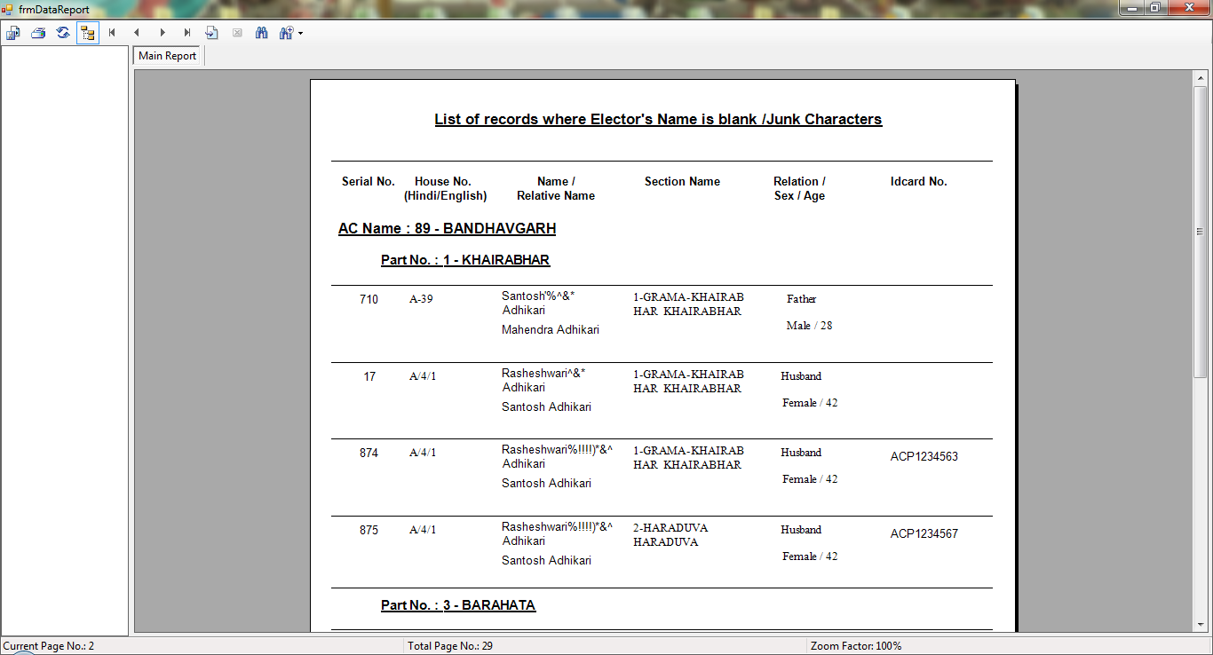
IDENTIFYING ERRORS
IN THE ROLL
If any of these 17 errors exist in the roll, they would appear in the PS wise Error Report which can be generated on computer in the format shown on the side by using the ERMS software and E-Roll Database.
Each trainee BLO should carefully see which probable errors have been identified in this report by the computer.
He should plan to verify them.
DEO or ERO should generate the error report shown on the side for each PS of every AC before training, and provide its print to the BLOs participating in the training.
States which do not use ECI’s ERMS application, should develop and use similar applications for this purpose.
If it is not possible to generate these error reports on computer before training of BLOs, then BLOs should manually identify such errors during the training program itself.

Slide 125
FORMULATING STRATEGY &
PLAN OF ACTION
FOR
IMPROVING THE ROLL
AFTER
HEALTH ANALYSIS &
ERROR IDENTIFICATION

Slide 126
FORMULATING STRATEGY & POA
DURING THE TRAINING
After doing Health Analysis & Error Identification, each trainee BLO should use these learnings to formulate at least 5 to 10 Points of Strategy & a Plan of Action for Improving the Roll of his PS DURING THE TRAINING ITSELF
He should think of different approaches he will adopt to make his roll accurate, error-free & updated
Trainers, AEROs, EROs & DEOs should help their BLOs make efficient & feasible strategies and plans, and should forward them to their CEOs

Slide 127
FORMULATING STRATEGY & POA
      POINTS TO PONDER
Gender
In-migration/ Out-migration
High death rate
Student population
Change in the boundary of the part area; New habitation
Industrial labour/ Agricultural Labour
Apartments with access control
Inaccessible areas – deeply forested, river crossing etc.;
Absence of RWAs; Defunct Gram Sabha…
      Think of more such categories & Action Points for Inclusion and Facilitation

Slide 128
FORMULATING STRATEGY & POA
An exhaustive list of strategic points should be drawn for all the problems and issues the trainee BLO identified in the previous exercise.
Some illustrative examples could be:
    Gender ratio in my Polling Station is less than the district & assembly constituency - I need to check & ensure that all eligible women are enrolled.
    While passing by my Polling Station area, I noticed a new colony has come up – I need to ensure that all the residents (tenants & landlords) are registered.
    A new industrial factory has been set up in my part area – I need to register all the migrant labourers working in the factory.
    Very few trans-genders enrolled compared to the assembly constituency – I need to verify & visit houses of all trans-genders in my part area & register them.

Slide 129
FORMULATING STRATEGY & POA
See the Points of Health Analysis & the Details of Identifiable Errors discussed in the foregoing slides to further strengthen your Points of Strategy & Plan of Action

Slide 130
HELPING HANDS
GRAM SABHA
BOOTH LEVEL AGENT (BLA)

Slide 131
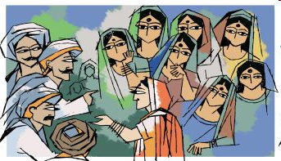
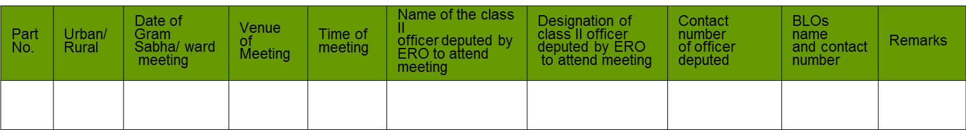
GRAM SABHAS AND ROLE OF BLOs
BLOs read out the list of the following to the sabha:
- Addition, Deletion, and Modification of names,
- Duplicate names,
- Details of the households with more than 10 voters
The reading is done with an order issued under the signature of the concerned ERO. The following details are covered in the order
  Name of AC: ______________
Courtesy: http://www.indiatogether.org/2005/sep/wom-attend.htm

Slide 132
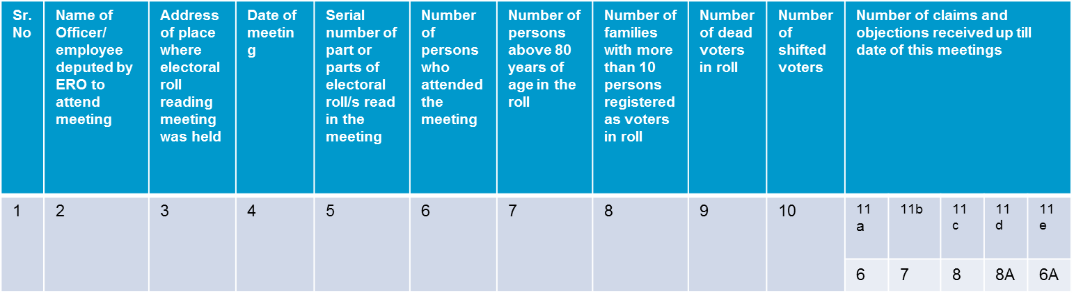
REPORTING THE MEETING
BLOs submit a report on completion of the meeting in the given format
Report by BLO of Reading of Electoral Roll of Part in Gram Sabha/Ward Meeting
Signature of Talati
Name of Talalti
Village/Sehra:
Signature of BLO
Name of BLO
Designation
Part No : AC Name:
Signature of officer deputed
Name of Officer
Designation of Officer
Please note: This report is to be send directly to the Office of the concerned AERO, with a copy marked to the concerned ERO
* List of names given in column 7, 8, 9, 10 to be read out in the Gram Sabha

Slide 133

BOOTH LEVEL AGENTS (BLAs)
BLAs are officers appointed by the political parties under the direction of Election Commission, to help BLOs in Electoral Roll Management.
Duties
  Assists people in filing claim/objection properly
  Remains present during the campaigns and help BLOs
  Verifies and conducts survey of the dead and shifted electors
  Is responsible if the survey is faulty
  Understands and scrutinizes the electoral roll during meeting with BLO
  Helps continuous updating of the electoral roll
Informs
Appoints
Election Commission
Political Party
Booth Level Agents

Slide 134
NATIONAL VOTERS DAY

Slide 135
WHAT IS NATIONAL VOTERS DAY?
National Voters Day
Election Commission of India (ECI) was established on 25th January, 1950;
National Voters Day is celebrated on the founding day of ECI i.e. 25th January every year;
Celebrated for the first time in January 2011, called “Rashtriya Matdata Divas” in Hindi.

Slide 136





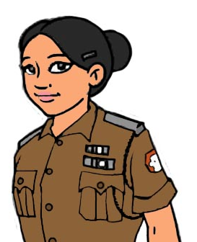


OBJECTIVE OF NATIONAL VOTERS DAY
To ensure maximum enrolment of youth
To spread awareness amongst voters of their rights and duties
To create awareness amongst voters about the process of enrolment
To request the participation of voters in helping the Election Officers to maintain clean and error free roles
To empower the youth and instil a sense of pride amongst them
To inspire youth to exercise their franchise
Vote
Vote
Vote

Slide 137
Role of BLO towards celebrating NVD
Role of BLO towards celebrating NVD
Role of BLO towards celebrating NVD
Role of BLO towards celebrating NVD
ROLE OF TOWARDS CELEBRATING NVD
Responsible for conducting voters’ education activities,
Identify and enroll all newly eligible (18+) electors,
Ensure that error free EPIC cards are given to the electors,
Distribute EPICs & badge - “Proud to be a Voter-ready to Vote” to the newly eligible voters on 25th January every year,
Administer the pledge to newly enrolled electors on NVD,
Maintain a list of Higher Secondary Schools/Colleges/Higher educational institutions in his Part Area for enrolling youth,
Locate & educate youth who do not go to such educational institutions and impart education on enrollment and duties as a voter.

Slide 138

PLEDGE
“ We, the citizens of India, having abiding faith in democracy, hereby pledge to uphold the democratic traditions of our country and the dignity of free, fair and peaceful elections, and to vote in every election fearlessly and without being influenced by considerations of religion, race, caste, community, language or any inducement.”

Slide 139
SUMMING UP – MAIN DUTIES & RESPONSIBILITIES OF BLOS
Revision Period
Structural revision and updating of rolls
Coordination with BLAs
Displaying draft rolls
Reading of rolls in gram sabhas
All through the year
Collects field information
Ensure availability of different forms
Maintaining the election related
documents
Special Direction
Photo coverage in the roll
Obtain geographical information of Part
area
Coordination with BLAs
Impart Systematic Voters Education
for Electoral Participation (SVEEP)
Distribution of voters slip before polls
Any other work under the instruction of
ERO/AERO
Periodical
Updating of the rolls
National Voters Day Activity Dec-Jan
Ensure correct serialization of houses
Prepare sketch map (Nazari Naksha)
Physical verification of rolls

Slide 140
CASE STUDIES ON ROLL REVISION

Slide 141
CASE STUDY 1
In one family their daughter-in-law, Sarita being a family member was a part of the electoral roll for that household. But she has been driven out of the house by the in-laws. Now to establish proof that Sarita does not stay in the household any more, her in-laws submit Form-7 for her.
Sarita has not been legally divorced with her husband, nor the family produce any such document. Even the family is reluctant to give any information of her present residence. What can the BLO do in such a situation?

Slide 142
CASE STUDY 2
A BLO visits an orphanage located in his Part, where orphans are brought up and looked after from infancy. He finds that ‘Ramesh' is eligible for enrolment as an elector. But ‘Ramesh' is not in a position to give the names of either his father or mother. ‘Chinmaya' too is eligible for enrolment as an elector and he reveals the true name of his biological mother.
What shall BLO enter in the column meant for father's/ mother's/husband's name for ‘Ramesh’ and ‘Chinmaya’? And what shall BLO enter in the relationship column in such cases?

Slide 143
CASE STUDY 3
In one 'Ashram' or 'Akhada' a 'Sadhu' or 'Saint' is eligible to be an elector. He does not reveal his worldly name but insists to be enrolled in his rechristened name with suffix of his Guru's name instead of his father.
What does BLO enter in the columns related to name of father/mother/husband & in column related to relationship?

Slide 144
CASE STUDY 4
An elector is enrolled in Part no. 35 of a particular AC. His name is in section-4, i.e. Satyam society. Now he has shifted to Riddhi-Siddhi colony which falls in section-2 of the same Part.
What is required to be done by the BLO to update his entry in the electoral roll?

Slide 145
CASE STUDY 5
Mr. Hemal applies under RTI to the BLO to provide him all the photo copies of Forms 6, 7, and 8. What should the BLO do?

Slide 146
CASE STUDY 6
The BLO reaches the house of Mr. Kantibhai. unknown to the BLO the son of Mr Kantibhai, that is, Mr. Ketanbhai is wanted in a criminal case. Mr. Kantibhai fills Form-7 for the deletion of name of Mr Ketanbhai on the pretext that his son has shifted to another State. Next when the BLO visits the neighbour of Mr Kantibhai , the neighbour informs the BLO that Mr Kantibhai still stays there and that he is hiding from the Police.
Should the BLO delete the name of Mr. Kantibhai on the basis of Form-7 filled by his father?

Slide 147
CASE STUDIES
ON EPIC
Notes:
20 MINUTES
Divide the class into 5 groups – distribute one case study to each group.
Ask them to read find out the roles of BLOs and share the same with the class

Slide 148
CASE STUDY 1
Mr. Ajay is a school teacher in village Fatehpur. Instead of teaching during school hours, he goes to distribute the EPIC cards. After 15 days he receives show cause notice from his Head Office that why he should not be suspended for being absent during the teaching hours.

Slide 149
CASE STUDY 2
Najma has filled Form-6 for addition of her name. Her name is entered in the rolls and EPIC card prepared accordingly and handed over to the BLO for distribution. When BLO tries to hand over the EPIC to Najma, she outrightly refuses to take the EPIC from the BLO on the grounds that the spelling of her name in the card is incorrect.
Instead of 'Najma' with a ‘j' in between, it has been written as as NAZMA with a ‘z' in between. Najma wants her EPIC to be corrected and argues that she will not fill up any more Forms again.

Slide 150
CASE STUDY 3
Mr. Naresh has rented a portion of his house to Mr. Bhatt.
Mr. Bhatt fills Form-6 for inclusion of his name in the voters list. His landlord Mr. Naresh writes an application to the ERO that Bhatt 's EPIC card should not be prepared at this address.
Now the ERO forwards the application to the BLO for enquiry. What should the BLO do?

Slide 151
CASE STUDY 4
A BLO visits a house in his Part. At the time of his visit, the following members are present:
    Trivedi Rameshbhai Ramesh bhai M-48
    Trivedi Kamlaben Rameshbhai F-45
    Trivedi Satish Rameshbhai M-23
    Trivedi Sudha Rameshbhai F-19
As per the BLO's existing Photo Electoral Roll record, against the name of Rameshbhai and of Kamlaben EPIC No GJ/07/125/583120 and EPIC No. GJ/07/123/583121 respectively is shown. While against the name of Satish EPIC no. HCX/0058398 is shown, Sudhaben has not been enrolled yet. At the time of verification Rameshbhai produces his EPIC no. LJM/4853394, his wife produces EPIC No. LJM/485353584 and Satish produces EPIC No. HCX/0058398. Their EPICs are original and entries are correct in all respects.
Upon inquiry Rameshbhai reveals that initially EPICs were issued to them during the year 2000 and the EPIC available with him and his wife is that one. They were later issued another EPIC at the new address where they shifted in 2004. They have lost those EPIC cards. The EPIC numbers entry shown against him and his wife are as per the EPICs issued in 2004. They shifted to the present address in 2007. Now they want fresh EPICs for all the four members of the family updated with age and address. Should the BLO recommend new EPICs for them and do the needful?

Slide 152
CASE STUDY 5
During revision of electoral rolls a BLO visits a mohalla/society.
Few voters don't have their names in roll at the new residence
Few have been enrolled in the roll but without photo image. Further, against the names of each of them, EPIC numbers are reflected but EPICs are not available for verification.
All are demanding latest EPICs. What should the BLO do?

Slide 153
CASE STUDY 6
A BLO wants to resign from his services as a BLO. Should an ERO accept his resignation? What should the ERO do?

Slide 154
FAQs ON ROLL REVISION
Q. Whether the BLO can accept the Forms during revision period?
Yes . During revision period , BLOs can be notified as designated officers for their parts by EROs. Then, they can receive the forms and give receipts for the same. [Thereafter, BLOs should give all such received forms to the designated officers sitting in the polling station, if they are different from BLOs]. Designated Officers will include them in Forms 9,10,11 and 11A and take further necessary action.
Q. What type of preliminary checking a BLO should do at the receiving time?
He should see that all important column are duly filled, particularly declaration part in Form 6 relating to previous address, where applicable, and the it is signed/thumb impression in case illiterate. He should also check that photo is affixed at appropriate box wherever provided by the applicant. Also check that supporting documents for address proof, age proof etc. are provided.

Slide 155
FAQs ON ROLL REVISION
Q. During verification at the time of revision, should BLOs receive and accept Forms 6, 7 etc.?
BLO is a verifying official only. During revision, he can receive the forms on being notified as a designated officer, but has no power to decide on their acceptance or rejection. He should verify the particulars given in the form and mention the facts. It is for ERO/AERO to take a decision , in the light of BLOs report.
Q. Whether the BLO can receive the Forms during continuous updating period?
Yes, the Commission has permitted for this. But after receiving he should , in turn, hand over to EROs office for further necessary actions.

Slide 156
RECAPITULATE
BLO register and checklist,
Health analysis of the electoral roll,
Error/problems identification,
Strategy formulation,
Gram Sabha and BLA,
National Voters Day,
Voters Slip,
Case Studies and FAQs

Slide 157
THANK YOU
Disclaimer:
This training material is for use in training of election officials. It should not be referred as guidelines of ECI. In case of any variance in this training material and ECI guidelines/ rules/ laws, the ECI guidelines/ rules/ laws shall prevail.

